Slide 1

Air Pollution to Mortality : A Case Study Using Regression
Abir Naha ( 201257 )
Anjan Kumar Kayal (201271 )
Arkonil Dhar ( 201279 )
Koyel Pramanick ( 201333 )
Suchismita Roy ( 201440 )
Under Guidance of
Prof. Sharmishtha Mitra
Dept. of Mathematics and Statistics
IIT Kanpur

Slide 2
PROBLEM STATEMENT
The Goal of this project is to study how various environmental and socio-economic factors affect human mortality and to check which factors affect mortality rate significantly.
For this, we try to fit a linear model to explain the mortality rate as a linear function of various environmental and socio-economic factors. We checked the validity of different assumptions and tried to provide a remedy in case an assumption is not satisfied.
In this context we have checked the validity for the assumptions: Normality, Homoscedasticity, Independence of Errors and Multicollinearity of the regressors.

Slide 3
DATA SOURCE
The data set that we used comes from McDonald and Schwing (1973), "Instabilities of Regression Estimates Relating Air Pollution to Mortality," Technometrics, 15, 463-481. The data can be found using the link ,
https://www1.udel.edu/htr/Statistics/Data/pollution.DAT
This data consists of 60 observations on 15 independent variables and a measure of mortality on 60 US metropolitan areas in 1959-1961.

Slide 4
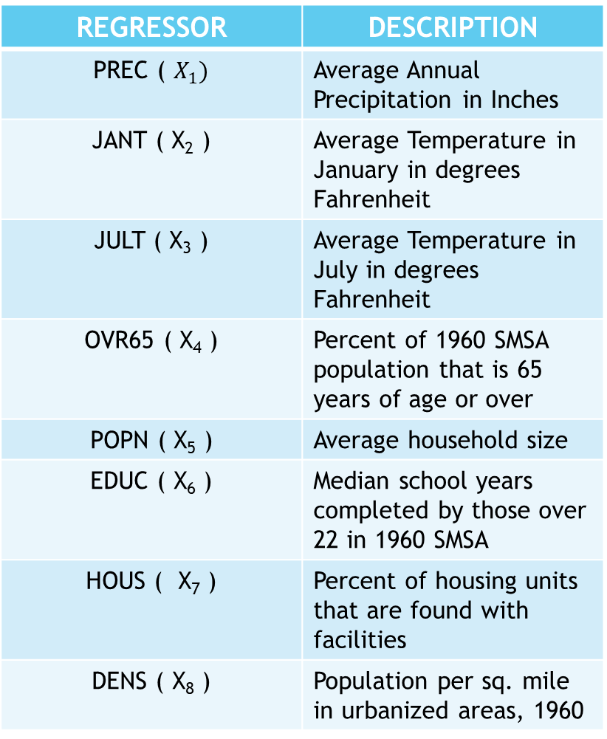
EXPLANATORY VARIABLE :
REGRESSOR | DESCRIPTION
PREC ( $X_{1})$ | Average Annual Precipitation in Inches
JANT ( X₂ ) | Average Temperature in January in degrees Fahrenheit
JULT ( X₃ ) | Average Temperature in July in degrees Fahrenheit
OVR65 ( X₄ ) | Percent of 1960 SMSA population that is 65 years of age or over
POPN ( X₅ ) | Average household size
EDUC ( X₆ ) | Median school years completed by those over 22 in 1960 SMSA
HOUS ( X₇ ) | Percent of housing units that are found with facilities
DENS ( X₈ ) | Population per sq. mile in urbanized areas, 1960
REGRESSOR | DESCRIPTION
NONW ( X₉ ) | Percent of non-white population in urbanized areas, 1960
WWDRK ( X₁₀ ) | Percent of population employed in white collar occupations
POOR ( X₁₁ ) | Percent of families with income less than 3000 dollars
HC ( X₁₂ ) | Relative pollution potential of hydrocarbons
NOX ( X₁₃ ) | Relative pollution potential of oxides of nitrogen
SO2 ( X₁₄ ) | Relative pollution potential of sulfur dioxide
HUMID ( X₁₅ ) | Percent relative humidity, annual average at 1 PM

Slide 5
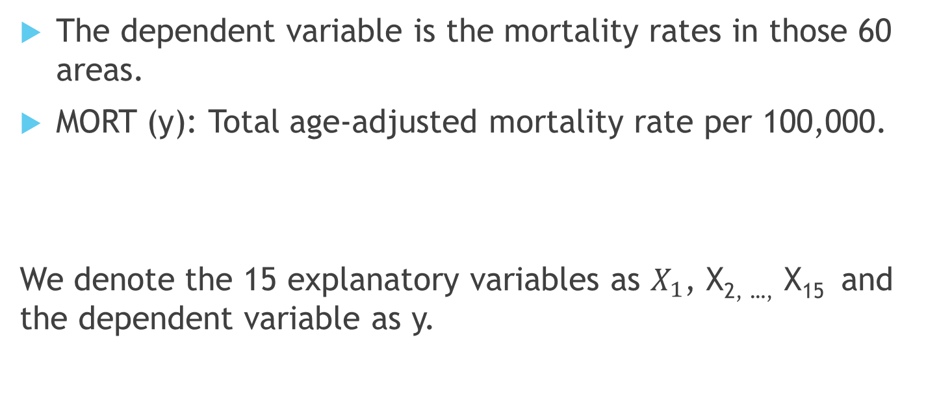
DEPENDENT VARIABLE :
The dependent variable is the mortality rates in those 60 areas.
MORT (y): Total age-adjusted mortality rate per 100,000.
We denote the 15 explanatory variables as $X_{1}$, X_{2, …,} X₁₅ and the dependent variable as y.

Slide 6
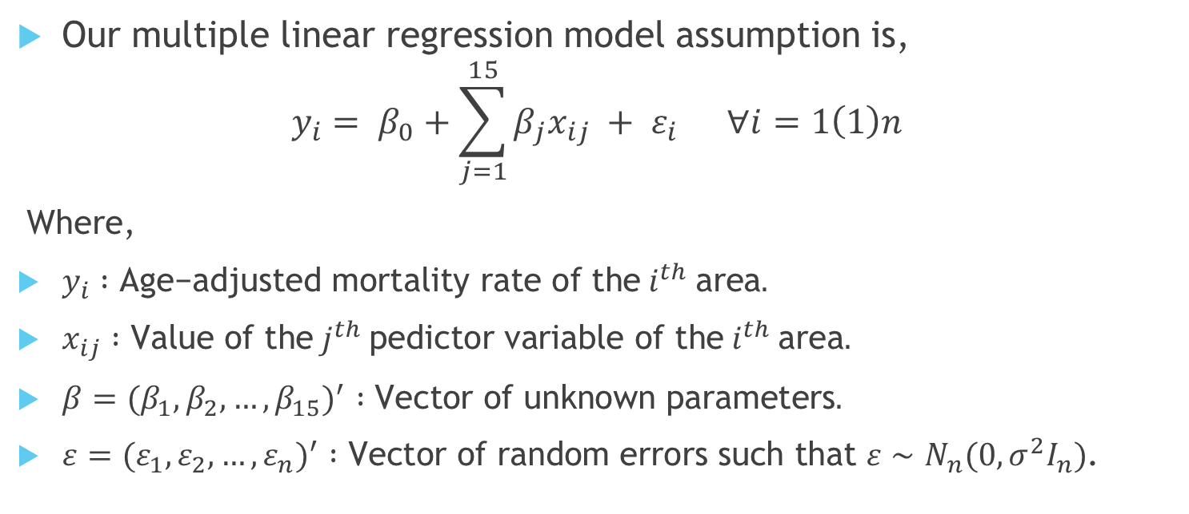
MODEL ASSUMPTION
Our multiple linear regression model assumption is,
$$y_{i}= β_{0}+\sum_{j=1}^{15}{β_{j}x_{ij} + ε_{i} ∀i=1\left(1\right)n}$$
Where,
$y_{i} :\text{Age}\text{−}\text{adjusted} \text{mortality} \text{rate} \text{of} \text{the} i^{th} \text{area}.$
$x_{ij} :\text{Value} \text{of} \text{the} j^{th} \text{pedictor} \text{variable} \text{of} \text{the} i^{th} \text{area}.$
$β=(β_{1}, β_{2}, …,β_{15})^{′} :\text{Vector} \text{of} \text{unknown} \text{parameters}.$
$ε=(ε_{1},ε_{2},…,ε_{n})^{′} :\text{Vector} \text{of} \text{random} \text{error}\text{s} \text{such} \text{that} ε∼N_{n}(0, σ^{2}I_{n})$.

Slide 7
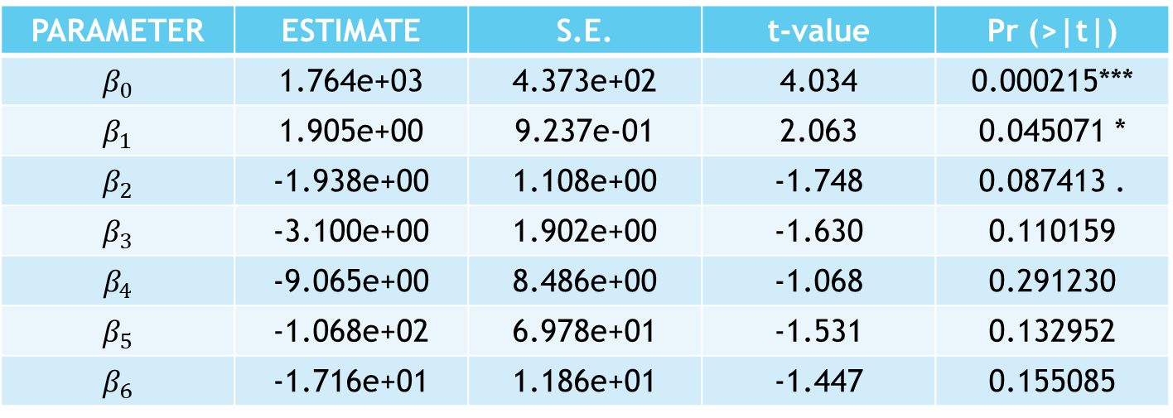
PARAMETER ESTIMATE:
The estimated value of the parameters obtained by the method of least square estimation are given below,
PARAMETER | ESTIMATE | S.E. | t-value | Pr (>|t|)
$$β_{0}$$ | 1.764e+03 | 4.373e+02 | 4.034 | 0.000215***
$β_{1}$ | 1.905e+00 | 9.237e-01 | 2.063 | 0.045071 *
$$β_{2}$$ | -1.938e+00 | 1.108e+00 | -1.748 | 0.087413 .
$$β_{3}$$ | -3.100e+00 | 1.902e+00 | -1.630 | 0.110159
$$β_{4}$$ | -9.065e+00 | 8.486e+00 | -1.068 | 0.291230
$$β_{5}$$ | -1.068e+02 | 6.978e+01 | -1.531 | 0.132952
$$β_{6}$$ | -1.716e+01 | 1.186e+01 | -1.447 | 0.155085

Slide 8
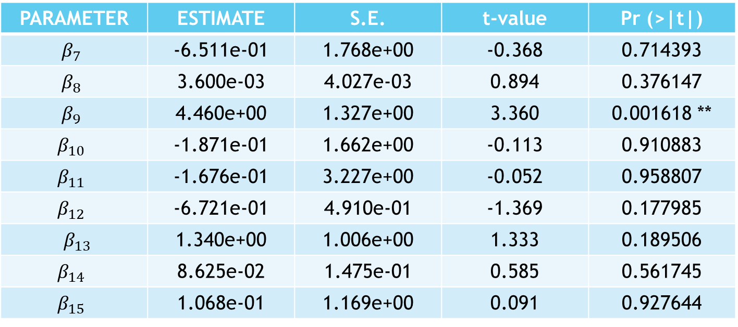
PARAMETER ESTIMATE:
The estimated value of the parameters obtained by the method of least square estimation are given below,
PARAMETER | ESTIMATE | S.E. | t-value | Pr (>|t|)
$$β_{7}$$ | -6.511e-01 | 1.768e+00 | -0.368 | 0.714393
$$β_{8}$$ | 3.600e-03 | 4.027e-03 | 0.894 | 0.376147
$$β_{9}$$ | 4.460e+00 | 1.327e+00 | 3.360 | 0.001618 **
$$β_{10}$$ | -1.871e-01 | 1.662e+00 | -0.113 | 0.910883
$$β_{11}$$ | -1.676e-01 | 3.227e+00 | -0.052 | 0.958807
$$β_{12}$$ | -6.721e-01 | 4.910e-01 | -1.369 | 0.177985
$β_{13}$ | 1.340e+00 | 1.006e+00 | 1.333 | 0.189506
$$β_{14}$$ | 8.625e-02 | 1.475e-01 | 0.585 | 0.561745
$$β_{15}$$ | 1.068e-01 | 1.169e+00 | 0.091 | 0.927644

Slide 9
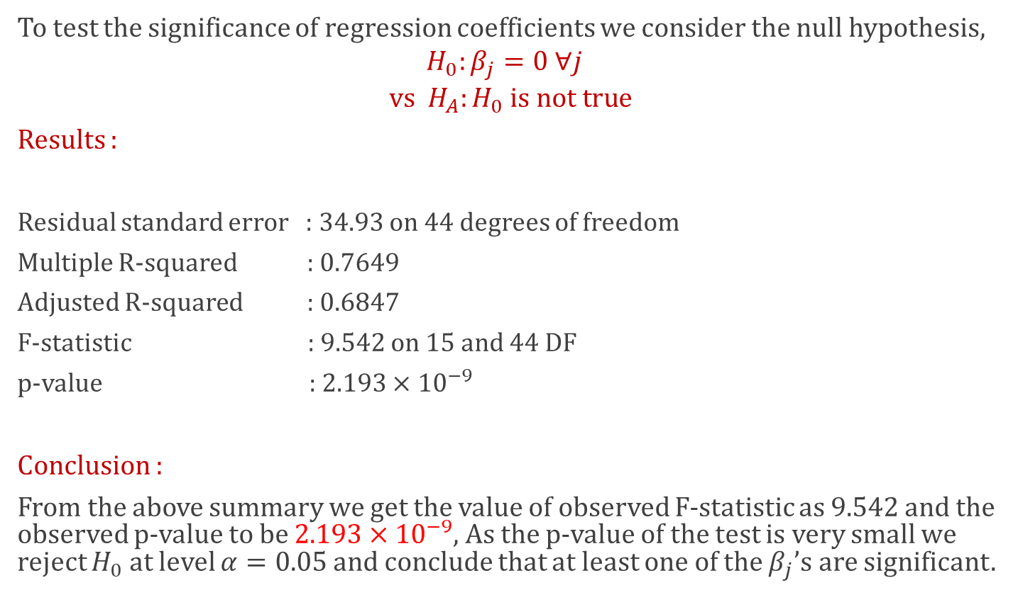
TEST OF SIGNIFICANCE OF REGRESSION COEFFICIENTS
To test the significance of regression coefficients we consider the null hypothesis,
$$H_{0}:β_{j}=0 ∀j$$
$$\text{vs} H_{A}:H_{0} \text{is} \text{not} \text{true}$$
Results :
Residual standard error : 34.93 on 44 degrees of freedom
Multiple R-squared : 0.7649
Adjusted R-squared : 0.6847
F-statistic : 9.542 on 15 and 44 DF
p-value : $2.193×{10}^{−9}$
Conclusion :
From the above summary we get the value of observed F-statistic as 9.542 and the observed p-value to be $2.193×{10}^{−9}$, As the p-value of the test is very small we reject $H_{0}$ at level $α=0.05$ and conclude that at least one of the $β_{j}$’s are significant.

Slide 10
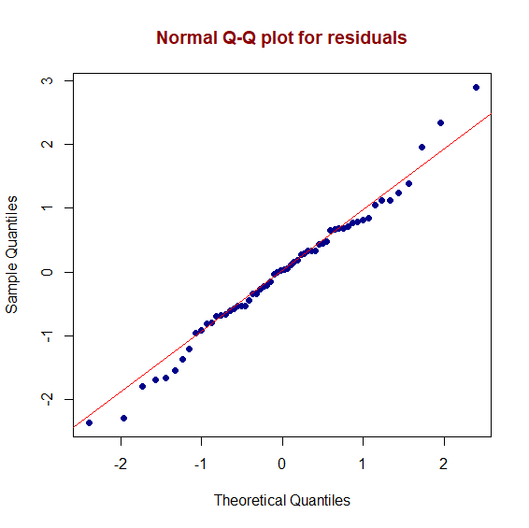
Checking error assumptions of MLR model:
Assumption 1: Errors are Normally Distributed
We plot QQ-plot and histogram of the errors to check if the errors comes from a normal distribution.
CONCLUSION:
In the QQ-plot we observe that almost all the points fall on the 45 degree straight line. This indicates that the normality assumptions of the errors are quite appropriate.

Slide 11
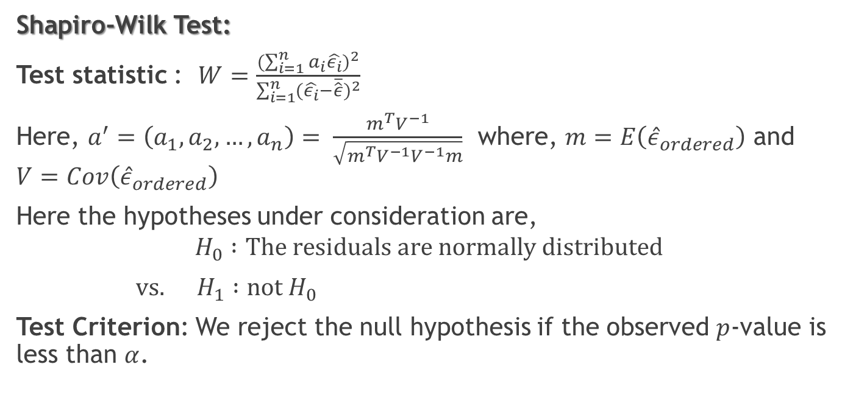
Shapiro-Wilk test and Anderson-Darling test for normality:
Shapiro-Wilk Test:
Test statistic : $W=\frac{(\sum_{i=1}^{n}{a_{i}\hat{ε_{i}}})^{2}}{\sum_{i=1}^{n}{(}\hat{ε_{i}}−\overline{\hat{ε}})^{2}}$
Here, $a^{′}=\left(a_{1}, a_{2},…,a_{n}\right)= \frac{m^{T}V^{−1}}{\sqrt{m^{T}V^{−1}V^{−1}m}}$ where, $m=E\left({\hat{ε}}_{ordered}\right)$ and $V=Cov\left({\hat{ε}}_{ordered}\right)$
Here the hypotheses under consideration are,
$$H_{0} :\text{The} \text{residuals} \text{are} \text{normally} \text{distributed}$$
$\text{vs}. H_{1} :\text{not} H_{0}$
Test Criterion: We reject the null hypothesis if the observed $p$-value is less than $α$.

Slide 12
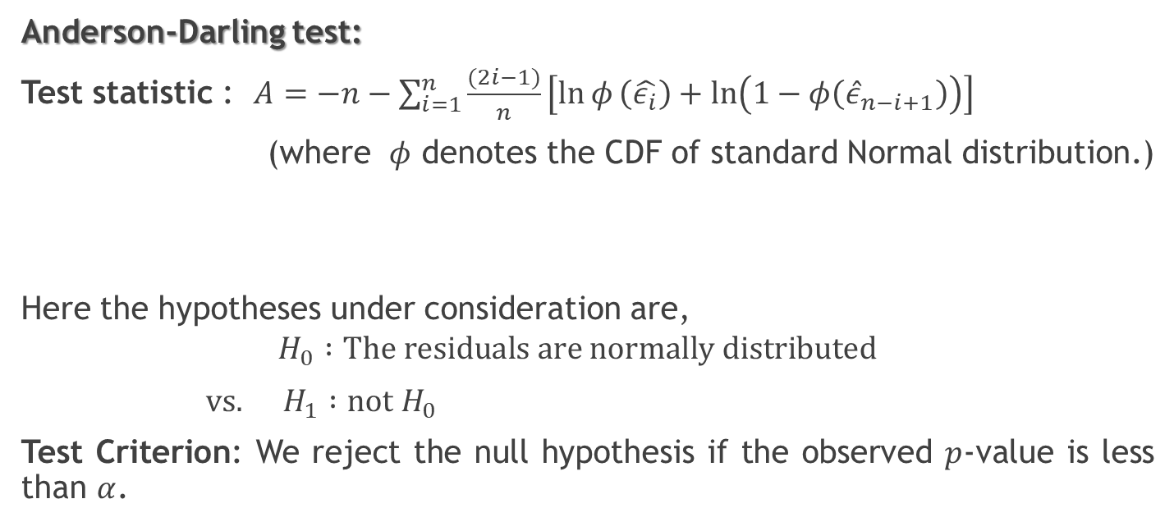
Shapiro-Wilk test and Anderson-Darling test for normality:
Anderson-Darling test:
Test statistic : $A=−n−\sum_{i=1}^{n}{\frac{(2i−1)}{n}\left[\ln{φ}\left(\hat{ε_{i}}\right)+ln\left(1−φ\left({\hat{ε}}_{n−i+1}\right)\right)\right]}$
(where $φ$ denotes the CDF of standard Normal distribution.)
Here the hypotheses under consideration are,
$$H_{0} :\text{The} \text{residuals} \text{are} \text{normally} \text{distributed}$$
$\text{vs}. H_{1} :\text{not} H_{0}$
Test Criterion: We reject the null hypothesis if the observed $p$-value is less than $α$.

Slide 13
Observation From Shapiro-Wilk Normality Test and Anderson-Darling Normality Test:
Shapiro-Wilk normality test yields :
the observed value of the test statistic W = 0.98274,
p-value = 0.5548
Anderson-Darling normality test yields :
the observed value of the test statistic A = 0.28142,
p-value = 0.6279
Conclusion:
Higher p-value (>0.05) for both the tests supports the null hypothesis that errors are normally distributed.

Slide 14
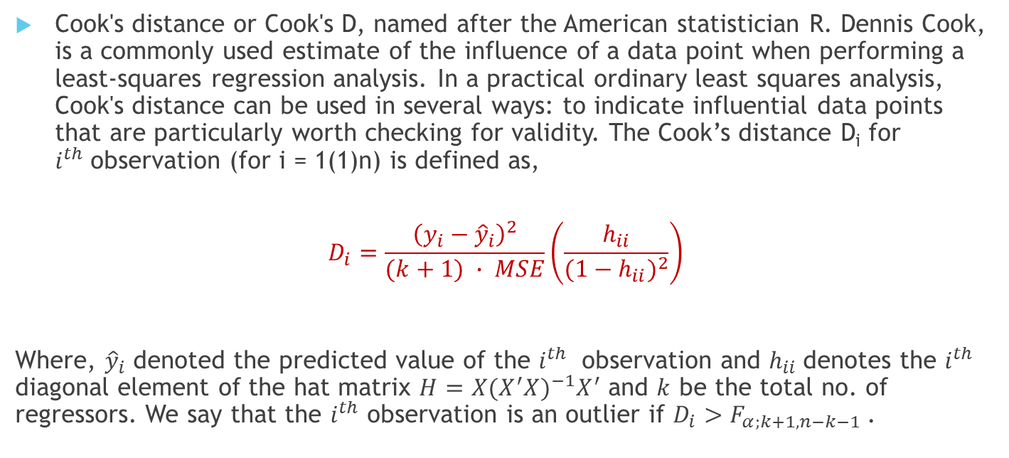
OUTLIER DETECTION
Cook's distance or Cook's D, named after the American statistician R. Dennis Cook, is a commonly used estimate of the influence of a data point when performing a least-squares regression analysis. In a practical ordinary least squares analysis, Cook's distance can be used in several ways: to indicate influential data points that are particularly worth checking for validity. The Cook’s distance D_{i} for $i^{th}$observation (for i = 1(1)n) is defined as,
$$D_{i}=\frac{{\left(y_{i}−{\hat{y}}_{i}\right)}^{2}}{(k+1) ∙ MSE}\left(\frac{h_{ii}}{(1−h_{ii})^{2}}\right)$$
Where, ${\hat{y}}_{i}$ denoted the predicted value of the $i^{th}$ observation and $h_{ii}$denotes the $i^{th}$ diagonal element of the hat matrix $H=X(X^{′}X)^{−1}X^{′}$ and $k$ be the total no. of regressors. We say that the $i^{th}$ observation is an outlier if $D_{i}>F_{α;k+1, n−k−1}$.

Slide 15
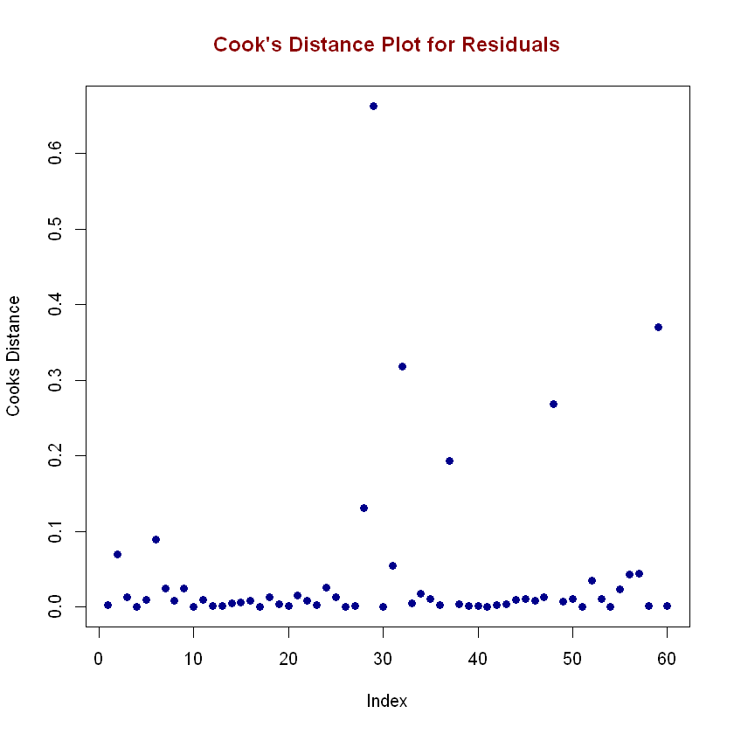
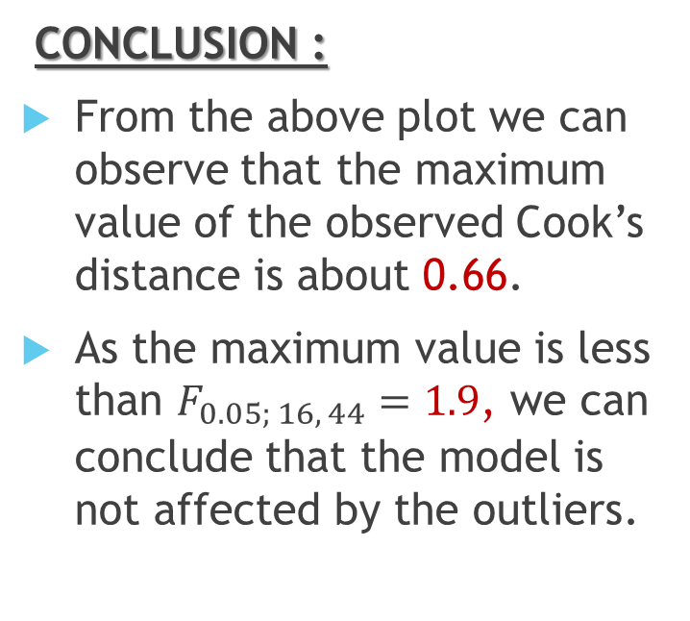
The plot of the corresponding Cook’s distance for the model is given below :
CONCLUSION :
From the above plot we can observe that the maximum value of the observed Cook’s distance is about 0.66.
As the maximum value is less than $F_{0.05; 16, 44}=1.9$, we can conclude that the model is not affected by the outliers.

Slide 16
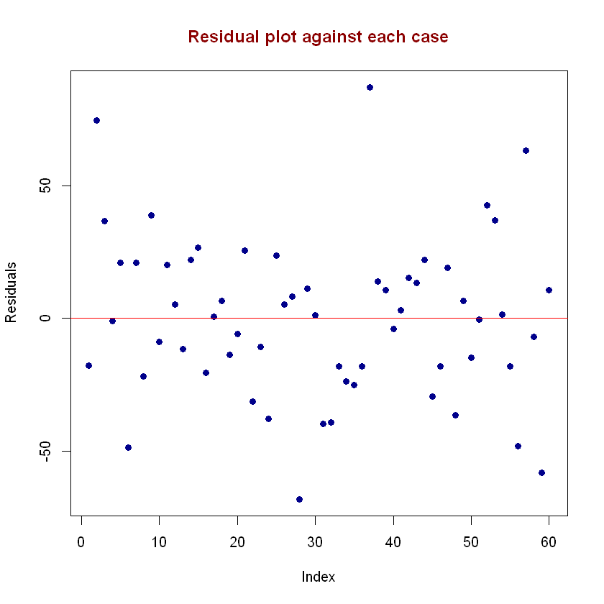
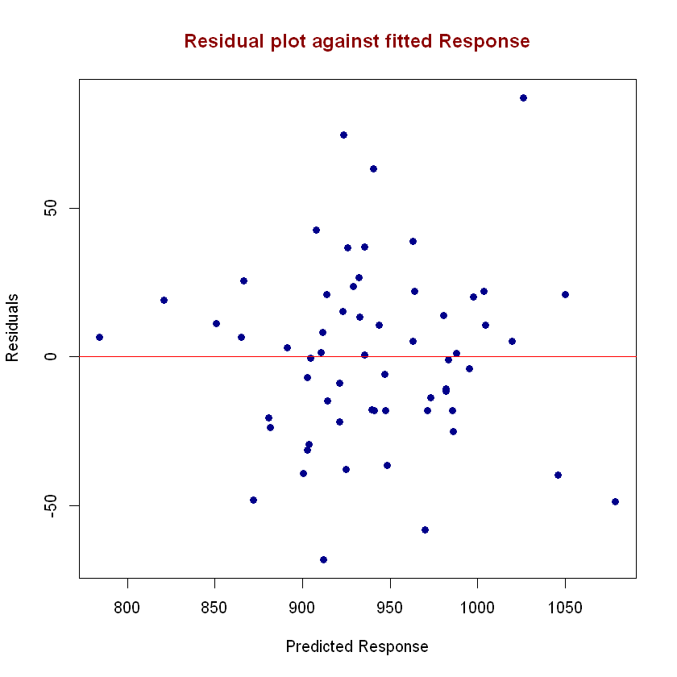
Assumption 2: Errors are Homoscedastic Now we check the homoscedasticity of errors. For this we make a scatterplot of the residuals and then plot the residuals against the fitted response.
Checking error assumptions of MLR model:
Conclusion :
There is no specific pattern among the residuals in the first plot indicating that there is no non-constant variance and the residuals are not correlated over different cases.
Again no pattern deleted in the plot against residuals against fitted response which indicates variance of residuals does not increase or decrease with predicted responses.

Slide 17
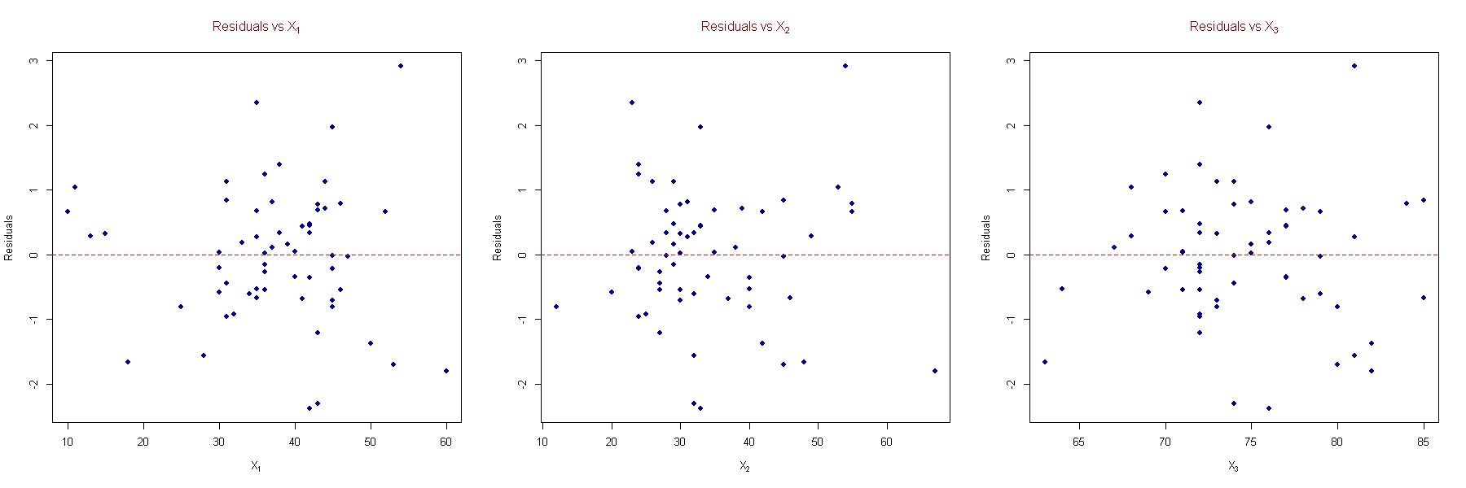
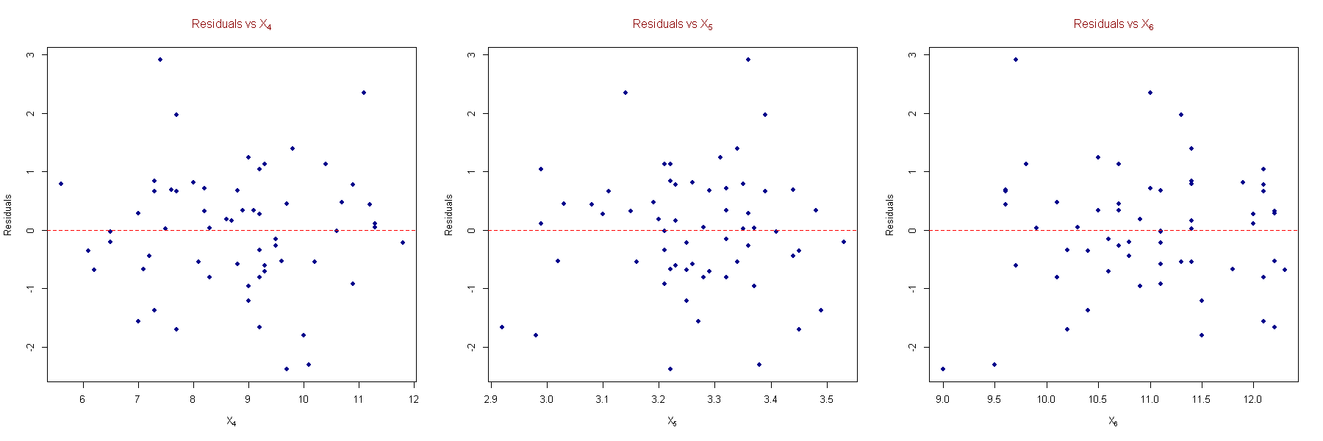
Now we plot the residuals against each regressor to check if the residuals are related to any of the explanatory variables

Slide 18
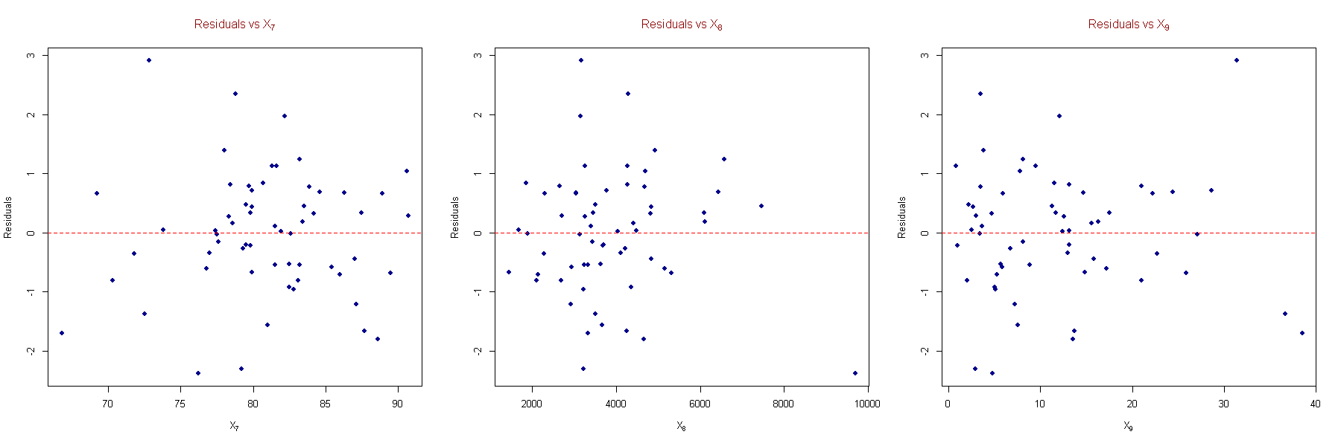
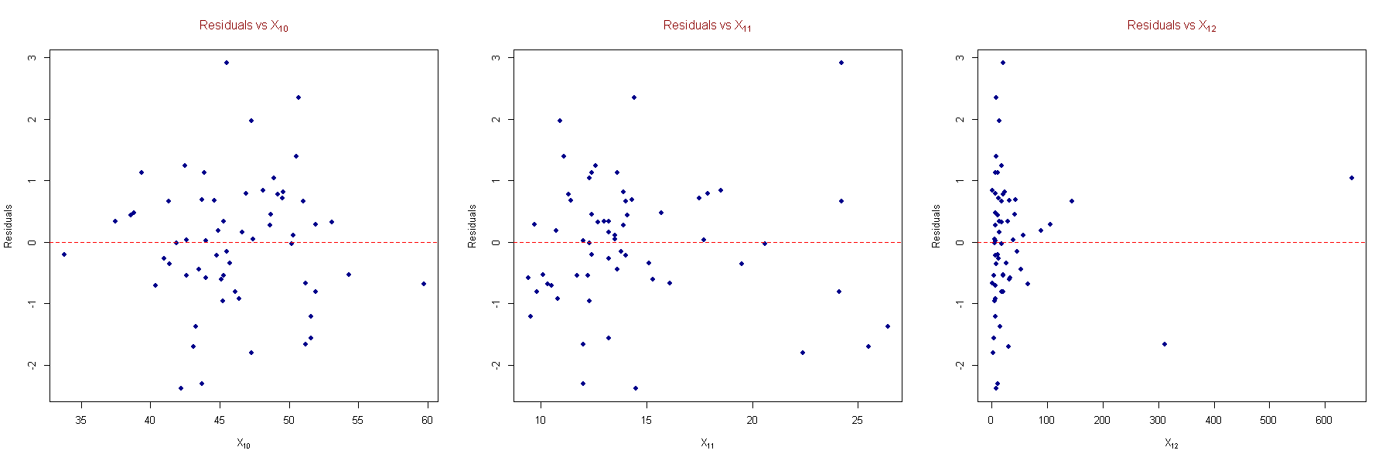
Now we plot the residuals against each regressor to check if the residuals are related to any of the explanatory variables

Slide 19
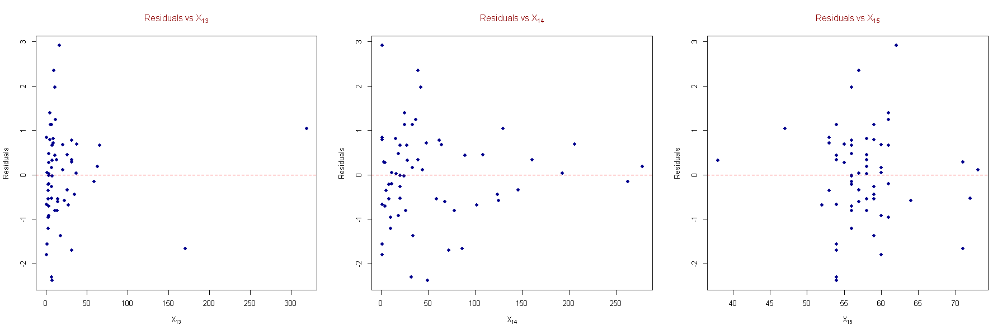
Now we plot the residuals against each regressor to check if the residuals are related to any of the explanatory variables
CONCLUSION:
From the plots we can't find any patterns of residuals for the regressors except for X₁₄. Hence the residuals can be assumed to be independently distributed with the regressors. Again, residuals are plotted randomly against each regressors, i.e. linear term in regressors are enough in the model. Hence no higher order term of the regressors is necessary.
In case of X₁₄ there seems to be an inward funnel in the plot. So, we are going for Glejser’s test and Golffeld-Quandt test for confirmation.

Slide 20
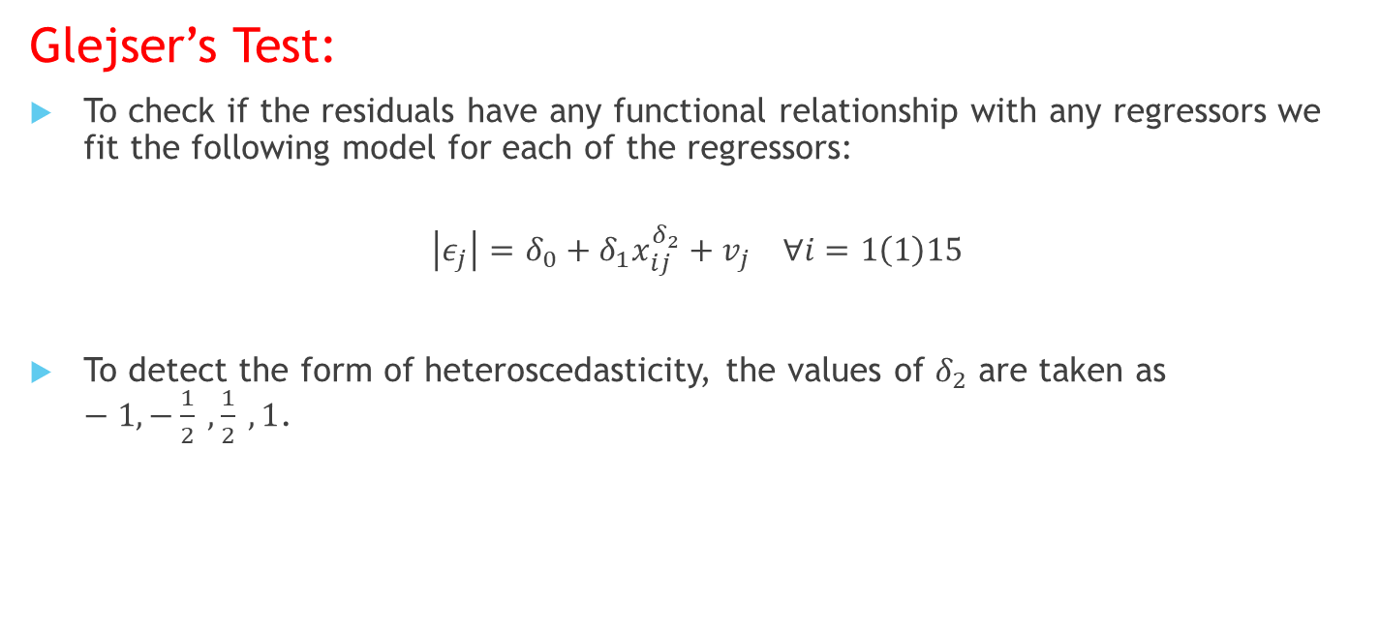
Glejser's Test and Goldfeld-Quandt Test:
Glejser’s Test:
To check if the residuals have any functional relationship with any regressors we fit the following model for each of the regressors:
$$\left|ε_{j}\right|=δ_{0}+δ_{1}x_{ij}^{δ_{2}}+v_{j} ∀i=1\left(1\right)15$$
To detect the form of heteroscedasticity, the values of $δ_{2}$ are taken as $−1, −\frac{1}{2} , \frac{1}{2} , 1$.

Slide 21
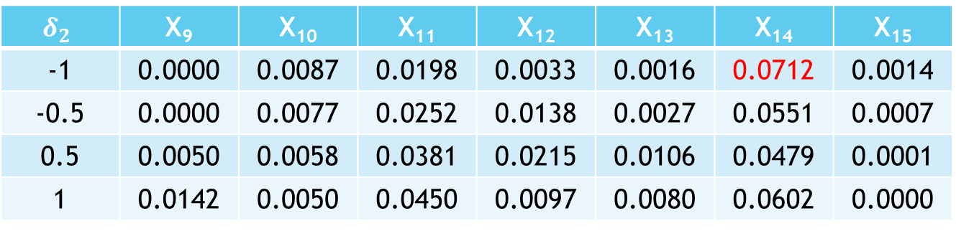
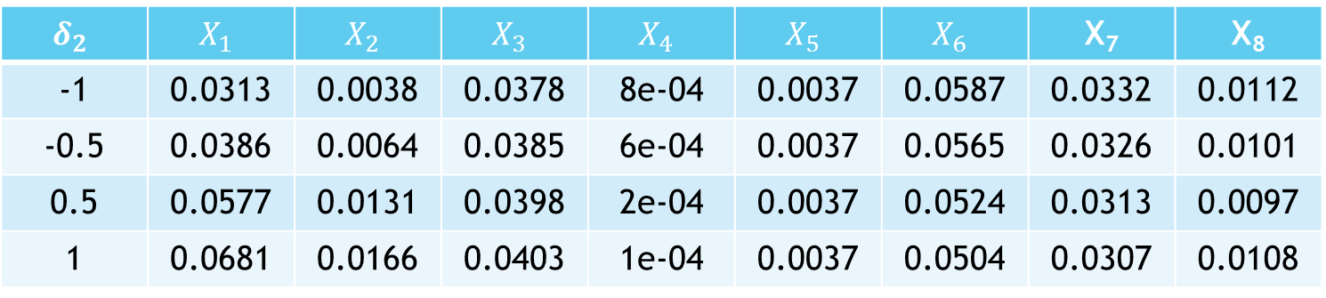

Glejser's Test and Goldfeld-Quandt Test:
Table for Showing $R^{2}$ values for each of the model:
$$δ_{2}$$ | $$X_{1}$$ | $$X_{2}$$ | $$X_{3}$$ | $$X_{4}$$ | $$X_{5}$$ | $$X_{6}$$ | X₇ | X₈
-1 | 0.0313 | 0.0038 | 0.0378 | 8e-04 | 0.0037 | 0.0587 | 0.0332 | 0.0112
-0.5 | 0.0386 | 0.0064 | 0.0385 | 6e-04 | 0.0037 | 0.0565 | 0.0326 | 0.0101
0.5 | 0.0577 | 0.0131 | 0.0398 | 2e-04 | 0.0037 | 0.0524 | 0.0313 | 0.0097
1 | 0.0681 | 0.0166 | 0.0403 | 1e-04 | 0.0037 | 0.0504 | 0.0307 | 0.0108
$$δ_{2}$$ | X₉ | X₁₀ | X₁₁ | X₁₂ | X₁₃ | X₁₄ | X₁₅
-1 | 0.0000 | 0.0087 | 0.0198 | 0.0033 | 0.0016 | 0.0712 | 0.0014
-0.5 | 0.0000 | 0.0077 | 0.0252 | 0.0138 | 0.0027 | 0.0551 | 0.0007
0.5 | 0.0050 | 0.0058 | 0.0381 | 0.0215 | 0.0106 | 0.0479 | 0.0001
1 | 0.0142 | 0.0050 | 0.0450 | 0.0097 | 0.0080 | 0.0602 | 0.0000
Comment: Here the highest value of $R^{2}$ corresponds to $X_{14}$ with $δ_{2}=−1$

Slide 22
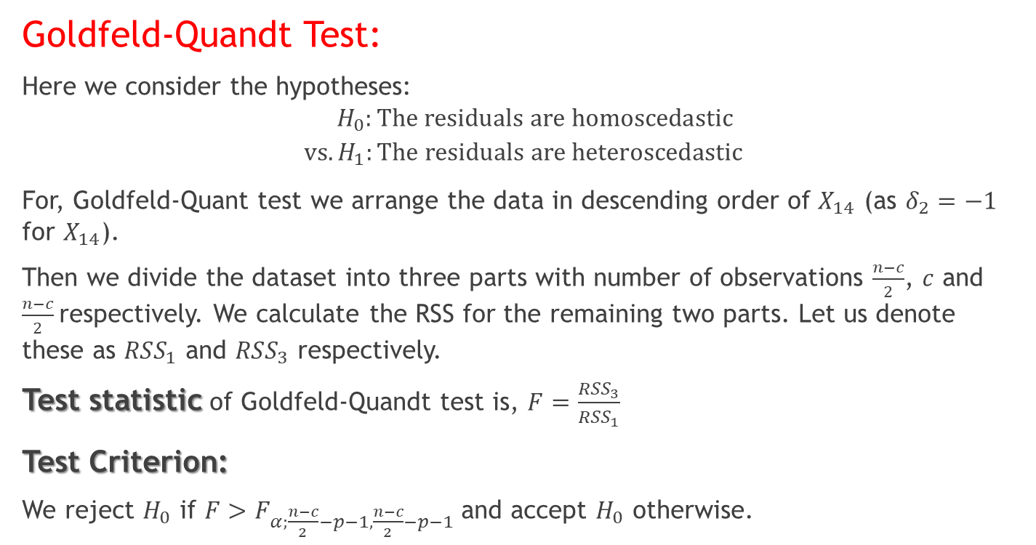
Glejser's Test and Goldfeld-Quandt Test:
Goldfeld-Quandt Test:
Here we consider the hypotheses:
$$H_{0}:\text{The} \text{residuals} \text{are} \text{homoscedastic}$$
$$\text{vs}. H_{1}:\text{The} \text{residuals} \text{are} \text{heteroscedastic}$$
For, Goldfeld-Quant test we arrange the data in descending order of $X_{14}$ (as $δ_{2}=−1$ for $X_{14}$).
Then we divide the dataset into three parts with number of observations $\frac{n−c}{2}$, $c$ and $\frac{n−c}{2}$respectively. We calculate the RSS for the remaining two parts. Let us denote these as ${RSS}_{1}$ and ${RSS}_{3}$ respectively.
Test statistic of Goldfeld-Quandt test is, $F=\frac{{RSS}_{3}}{{RSS}_{1}}$
Test Criterion:
We reject $H_{0}$ if $F>F_{α;\frac{n−c}{2}−p−1,\frac{n−c}{2}−p−1}$and accept $H_{0}$ otherwise.

Slide 23
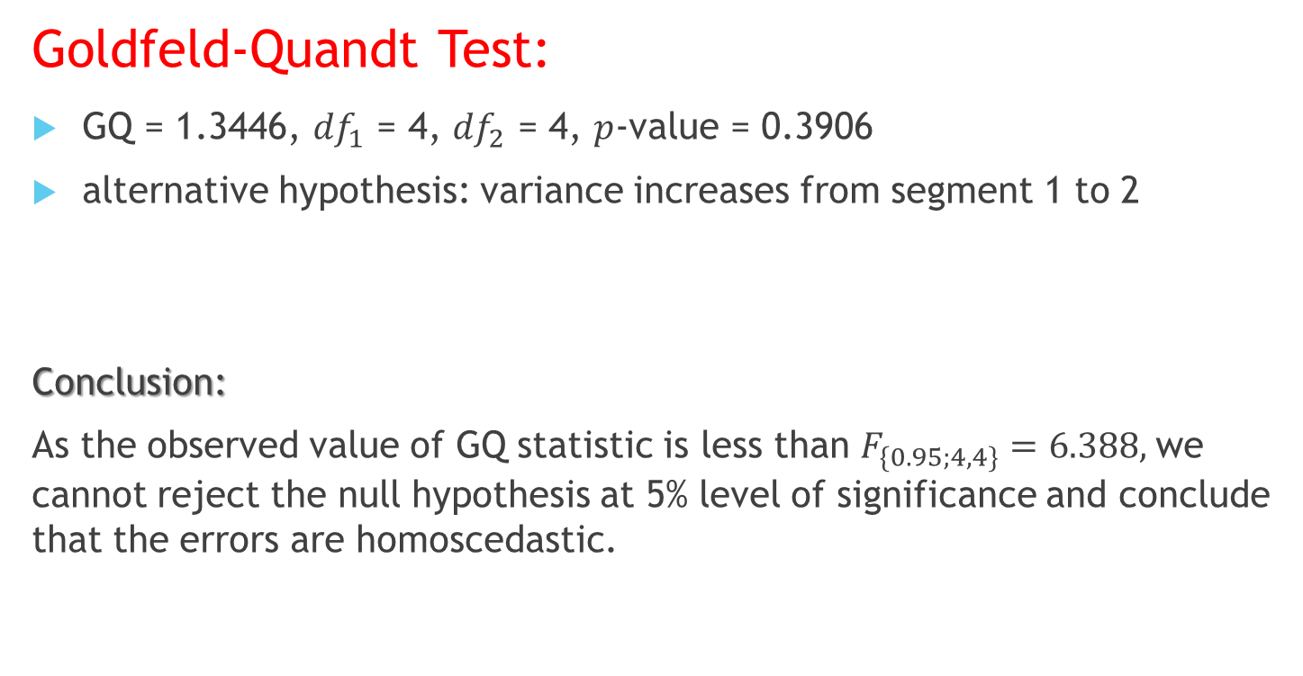
Glejser's Test and Goldfeld-Quandt Test:
Goldfeld-Quandt Test:
GQ = 1.3446, ${df}_{1}$ = 4, ${df}_{2}$ = 4, $p$-value = 0.3906
alternative hypothesis: variance increases from segment 1 to 2
Conclusion:
As the observed value of GQ statistic is less than $F_{\{0.95;4,4\}}=6.388,$we cannot reject the null hypothesis at 5% level of significance and conclude that the errors are homoscedastic.

Slide 24
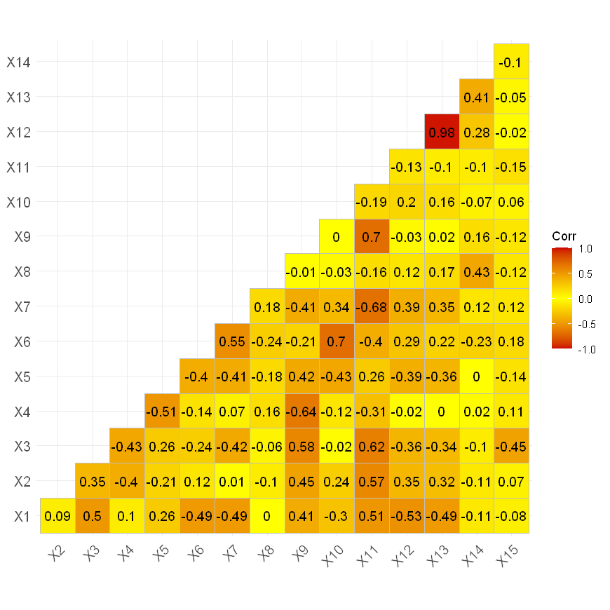
Checking for Multicollinearity:
In our model the condition number of X’X is 1253619451 which is very high i.e., X’X is ill-conditioned. This clearly indicates that there is multicollinearity in the regressors in the model.

Slide 25
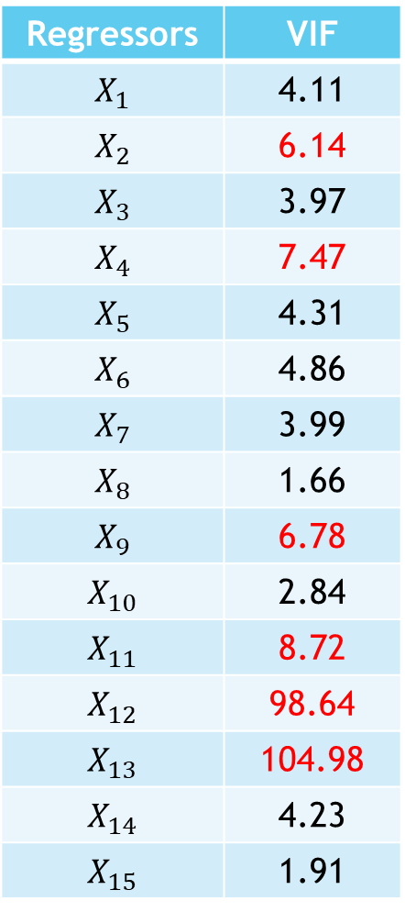
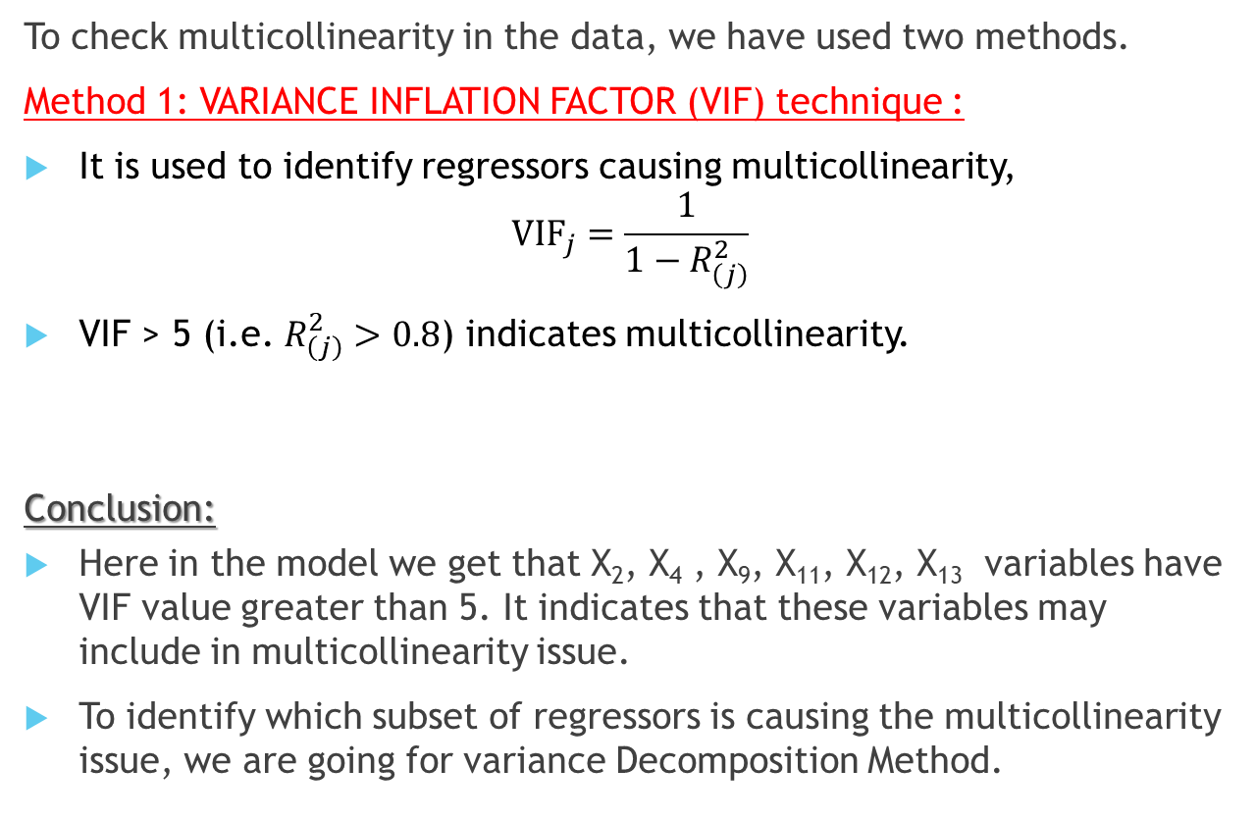
Multicollinearity Diagnosis:
Regressors | VIF
$$X_{1}$$ | 4.11
$$X_{2}$$ | 6.14
$$X_{3}$$ | 3.97
$$X_{4}$$ | 7.47
$$X_{5}$$ | 4.31
$$X_{6}$$ | 4.86
$$X_{7}$$ | 3.99
$$X_{8}$$ | 1.66
$$X_{9}$$ | 6.78
$$X_{10}$$ | 2.84
$$X_{11}$$ | 8.72
$$X_{12}$$ | 98.64
$$X_{13}$$ | 104.98
$$X_{14}$$ | 4.23
$$X_{15}$$ | 1.91
To check multicollinearity in the data, we have used two methods.
Method 1: VARIANCE INFLATION FACTOR (VIF) technique :
It is used to identify regressors causing multicollinearity,
$${\text{VIF}}_{j}=\frac{1}{1−R_{\left(j\right)}^{2}}$$
VIF > 5 (i.e. $R_{\left(j\right)}^{2}>0.8$) indicates multicollinearity.
Conclusion:
Here in the model we get that X₂, X₄ , X₉, X₁₁, X₁₂, X₁₃ variables have VIF value greater than 5. It indicates that these variables may include in multicollinearity issue.
To identify which subset of regressors is causing the multicollinearity issue, we are going for variance Decomposition Method.

Slide 26
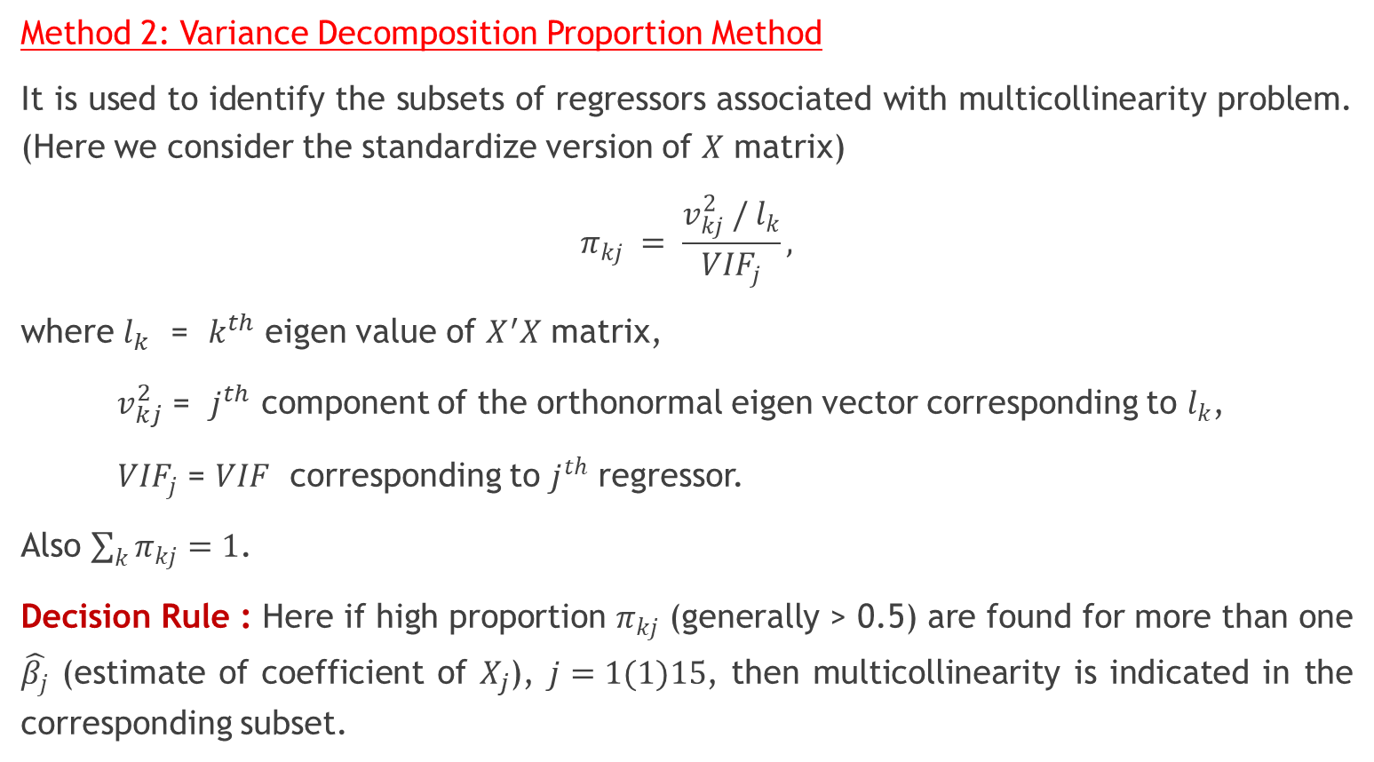
Multicollinearity Diagnosis:
Method 2: Variance Decomposition Proportion Method
It is used to identify the subsets of regressors associated with multicollinearity problem. (Here we consider the standardize version of $X$ matrix)
$$π_{kj} = \frac{v_{kj}^{2} / l_{k}}{{VIF}_{j}},$$
where $l_{k}$ = $k^{th}$ eigen value of $X^{′}X$ matrix,
$v_{kj}^{2}$ = $j^{th}$ component of the orthonormal eigen vector corresponding to $l_{k}$,
${VIF}_{j}$ = $VIF$ corresponding to $j^{th}$ regressor.
Also $\sum_{k}{π_{kj}=1}$.
Decision Rule : Here if high proportion $π_{kj}$ (generally > 0.5) are found for more than one $\hat{β_{j}}$ (estimate of coefficient of $X_{j}$), $j=1(1)15$, then multicollinearity is indicated in the corresponding subset.

Slide 27
Multicollinearity Diagnosis:
Results from Variance Decomposition Method:
Using Variance Decomposition Method we have obtained that,
Corresponding to the 2nd lowest eigen value the proportion corresponding to X₂, X₄, X₉, X₁₁ are greater than 0.5
And corresponding to the lowest eigen value the proportion corresponding to X₁₂, X₁₃, X₁₄ are greater than 0.5.
For further verification, whether the linear relation among these subsets are at all significant or not, we are proceeding to test significance of linearity with each of the subsets.

Slide 28
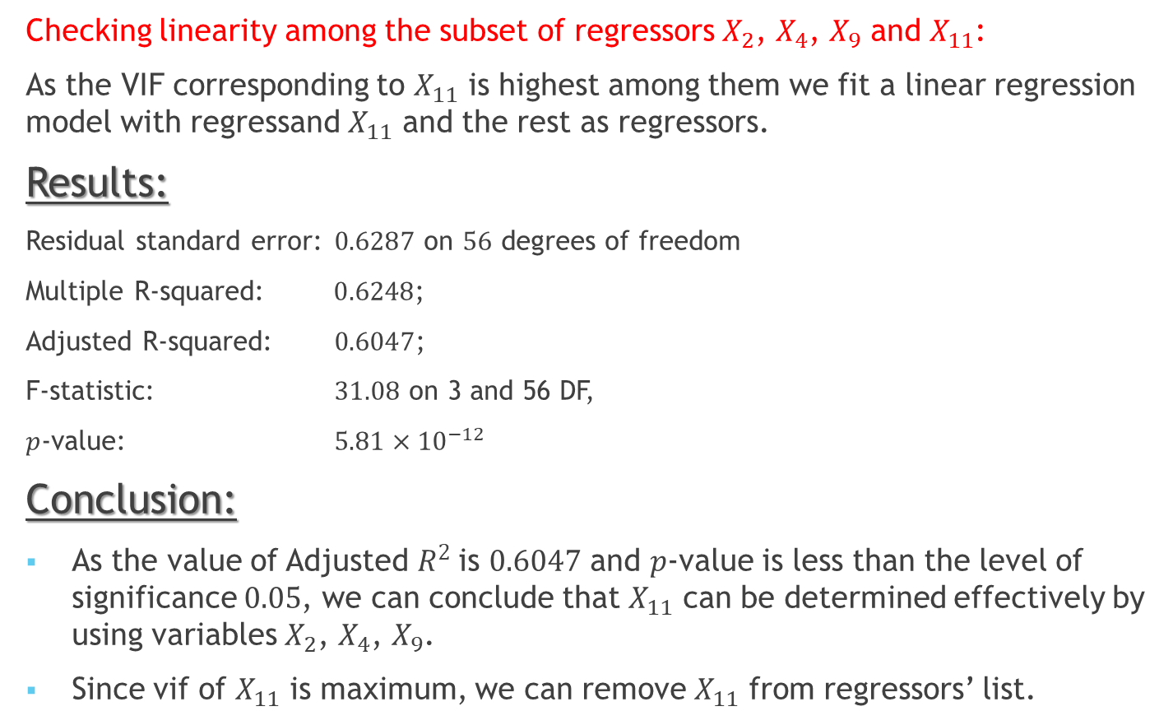
Multicollinearity Diagnosis:
Checking linearity among the subset of regressors $X_{2}$, $X_{4}$, $X_{9}$ and $X_{11}$:
As the VIF corresponding to $X_{11}$ is highest among them we fit a linear regression model with regressand $X_{11}$ and the rest as regressors.
Results:
Residual standard error: $0.6287$ on $56$ degrees of freedom
Multiple R-squared: $0.6248$;
Adjusted R-squared: $0.6047$;
F-statistic: $31.08$ on 3 and 56 DF,
$p$-value: $5.81×{10}^{−12}$
Conclusion:
As the value of Adjusted $R^{2}$is $0.6047$ and $p$-value is less than the level of significance $0.05$, we can conclude that $X_{11}$ can be determined effectively by using variables $X_{2}$, $X_{4}$, $X_{9}$.
Since vif of $X_{11}$ is maximum, we can remove $X_{11}$ from regressors’ list.

Slide 29
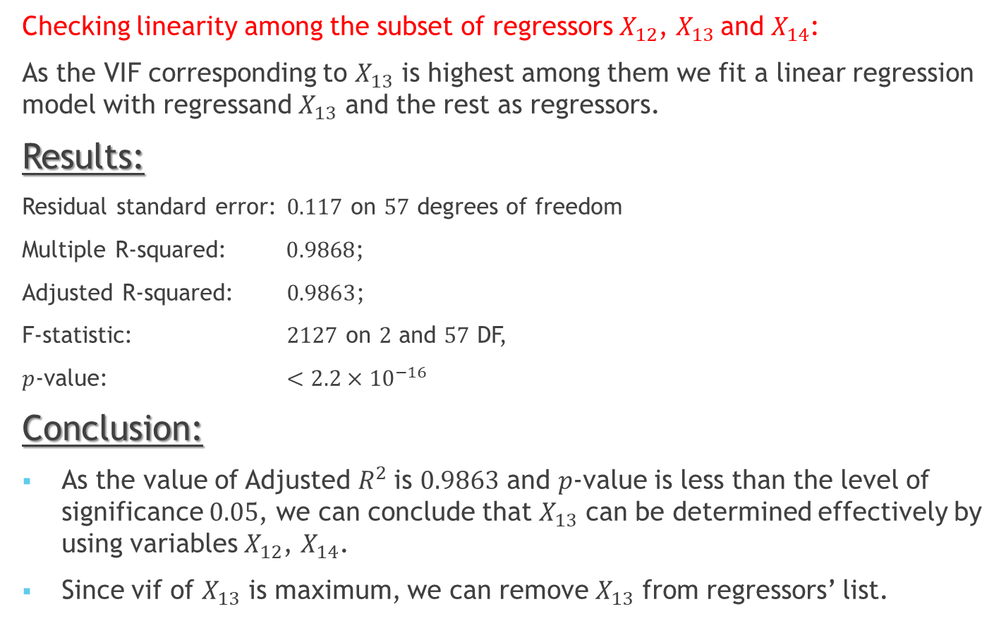
Multicollinearity Diagnosis:
Checking linearity among the subset of regressors $X_{12}$, $X_{13}$and $X_{14}$:
As the VIF corresponding to $X_{13}$ is highest among them we fit a linear regression model with regressand $X_{13}$ and the rest as regressors.
Results:
Residual standard error: $0.117$ on $57$ degrees of freedom
Multiple R-squared: $0.9868$;
Adjusted R-squared: $0.9863$;
F-statistic: $2127$ on $2$ and $57$ DF,
$p$-value: $<2.2×{10}^{−16}$
Conclusion:
As the value of Adjusted $R^{2}$is $0.9863$ and $p$-value is less than the level of significance $0.05$, we can conclude that $X_{13}$ can be determined effectively by using variables $X_{12}$, $X_{14}$.
Since vif of $X_{13}$ is maximum, we can remove $X_{13}$ from regressors’ list.

Slide 30
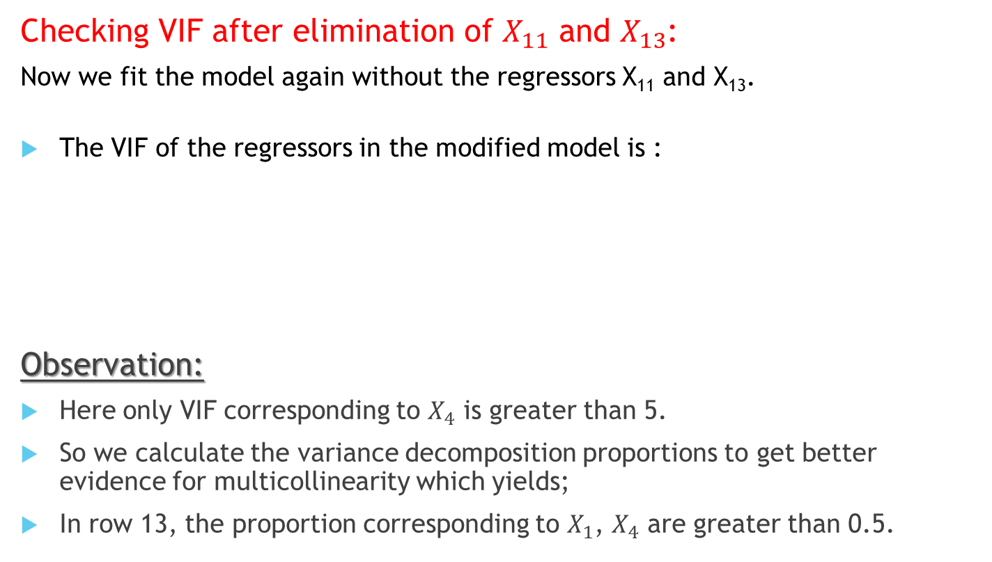
Multicollinearity Diagnosis:
Checking VIF after elimination of $X_{11}$ and $X_{13}$:
Now we fit the model again without the regressors X₁₁ and X₁₃.
The VIF of the regressors in the modified model is :
Observation:
Here only VIF corresponding to $X_{4}$ is greater than 5.
So we calculate the variance decomposition proportions to get better evidence for multicollinearity which yields;
In row 13, the proportion corresponding to $X_{1}$, $X_{4}$ are greater than 0.5.
Reg | X₁ | X₂ | X₃ | X₄ | X₅ | X₆ | X₇ | X₈ | X₉ | X₁₀ | X₁₂ | X₁₄ | X₁₅
VIF | 3.89 | 3.35 | 3.88 | 6.06 | 4.18 | 4.39 | 2.46 | 1.64 | 4.86 | 2.56 | 3.30 | 1.77 | 1.82

Slide 31
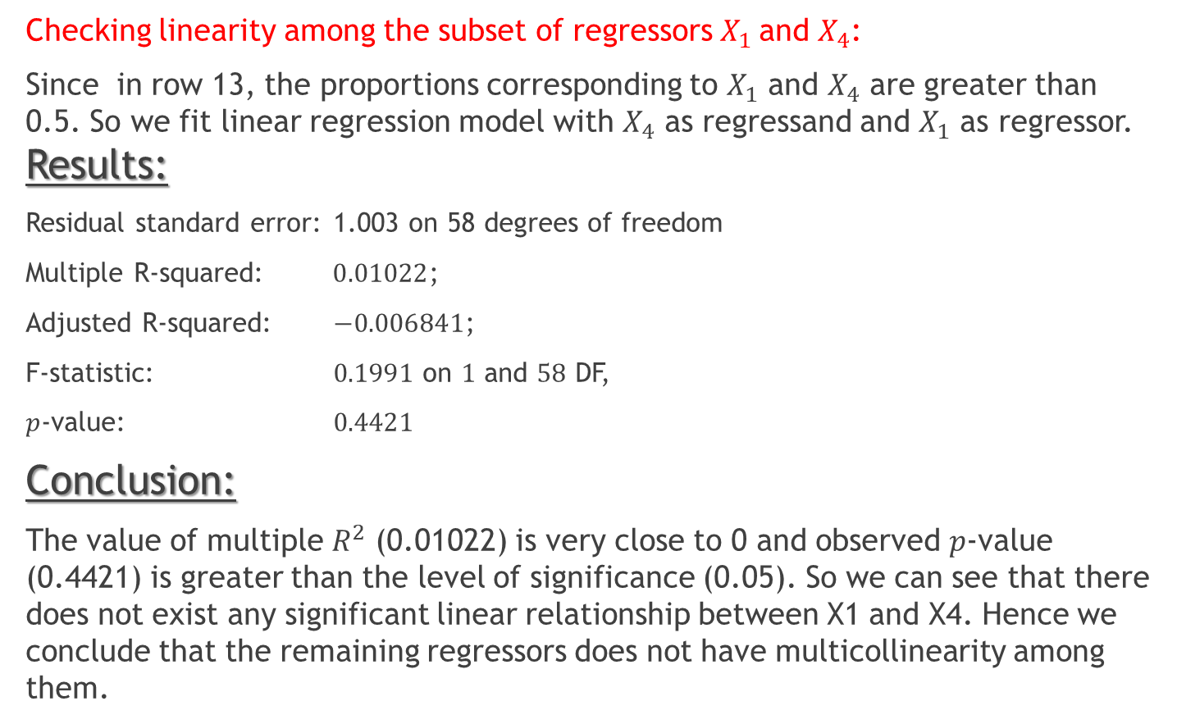
Multicollinearity Diagnosis:
Checking linearity among the subset of regressors $X_{1}$and $X_{4}$:
Since in row 13, the proportions corresponding to $X_{1}$ and $X_{4}$ are greater than 0.5. So we fit linear regression model with $X_{4}$ as regressand and $X_{1}$ as regressor. Results:
Residual standard error: 1.003 on 58 degrees of freedom
Multiple R-squared: $0.01022$;
Adjusted R-squared: $−0.006841$;
F-statistic: $0.1991$ on $1$ and $58$ DF,
$p$-value: $0.4421$
Conclusion:
The value of multiple $R^{2}$ (0.01022) is very close to 0 and observed $p$-value (0.4421) is greater than the level of significance (0.05). So we can see that there does not exist any significant linear relationship between X1 and X4. Hence we conclude that the remaining regressors does not have multicollinearity among them.

Slide 32

Model After Removing Multicollinearity:
The model after removing multicollinearity is as follows:
$$y_{i}= β_{0}+ \sum_{j=1}^{10}{β_{j}x_{ij} + β_{12}x_{12}+ β_{14}x_{14}+β_{15}x_{15}+ε_{i} ; ∀i=1\left(1\right)n}$$

Slide 33
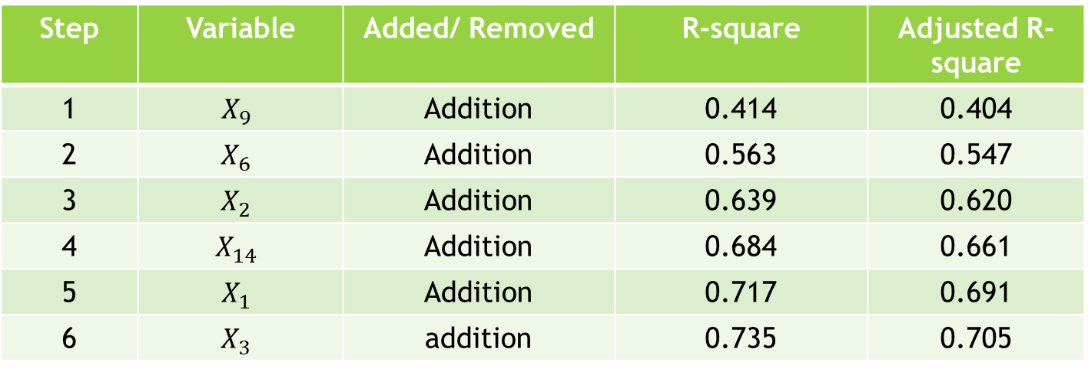

Variable Selection:
STEPWISE SELECTION SUMMARY:
CONCLUSION:
Hence after performing stepwise variable selection method, we are left with 6 regressors viz. $X_{1}$, $X_{2}$, $X_{3}$, $X_{6}$, $X_{9}$, and $X_{14}$. So we drop the remaining redundant regressors and continue analysis with these 6 regressors.
Step | Variable | Added/ Removed | R-square | Adjusted R-square
1 | $$X_{9}$$ | Addition | 0.414 | 0.404
2 | $$X_{6}$$ | Addition | 0.563 | 0.547
3 | $$X_{2}$$ | Addition | 0.639 | 0.620
4 | $$X_{14}$$ | Addition | 0.684 | 0.661
5 | $$X_{1}$$ | Addition | 0.717 | 0.691
6 | $$X_{3}$$ | addition | 0.735 | 0.705

Slide 34

Model After Variable Selection
Thus our new model is:
$$y_{i}=β_{0}+ β_{1}x_{1i}+β_{2}x_{2i}+β_{3}x_{3i}+β_{6}x_{6i}+β_{9}x_{9i}+β_{14}x_{14i}+ε_{i}$$
$$∀i=1\left(1\right)n$$
$\text{where} ε_{i }\sim N\left(0,σ^{2}\right) \text{independently},∀i=1\left(1\right)n.$

Slide 35
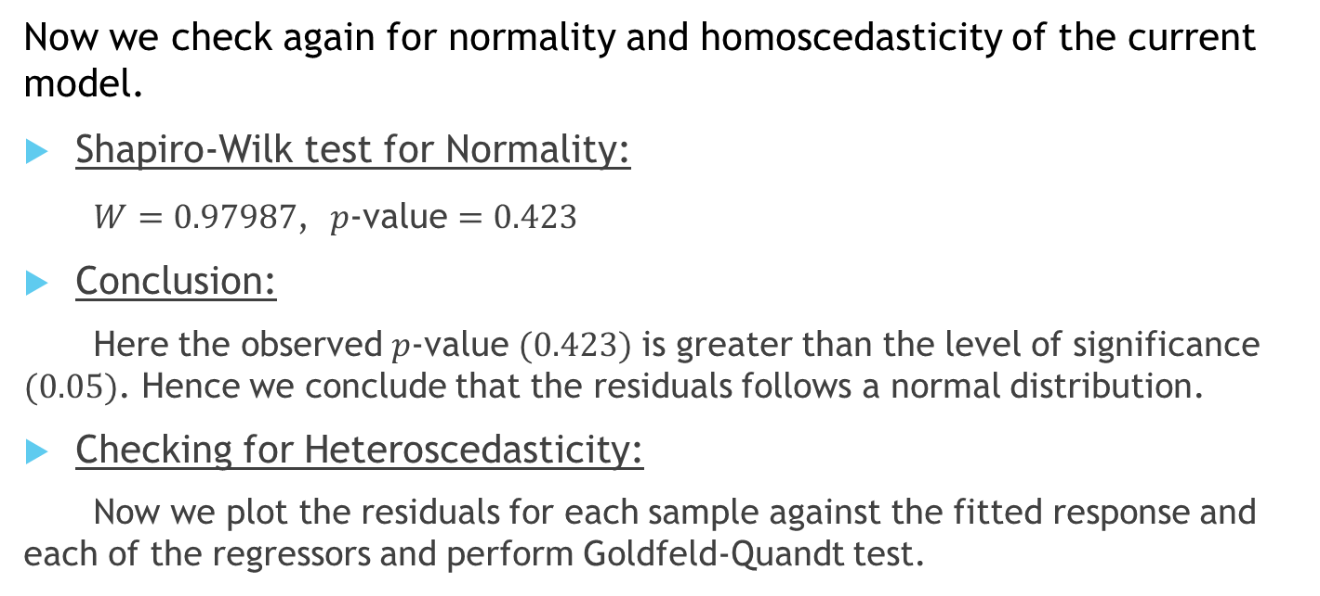
CHECKING ERROR ASSUMPTION OF THE FINAL MLR MODEL
Now we check again for normality and homoscedasticity of the current model.
Shapiro-Wilk test for Normality:
$W=0.97987$, $p$-value $=0.423$
Conclusion:
Here the observed $p$-value $(0.423)$ is greater than the level of significance $(0.05)$. Hence we conclude that the residuals follows a normal distribution.
Checking for Heteroscedasticity:
Now we plot the residuals for each sample against the fitted response and each of the regressors and perform Goldfeld-Quandt test.

Slide 36
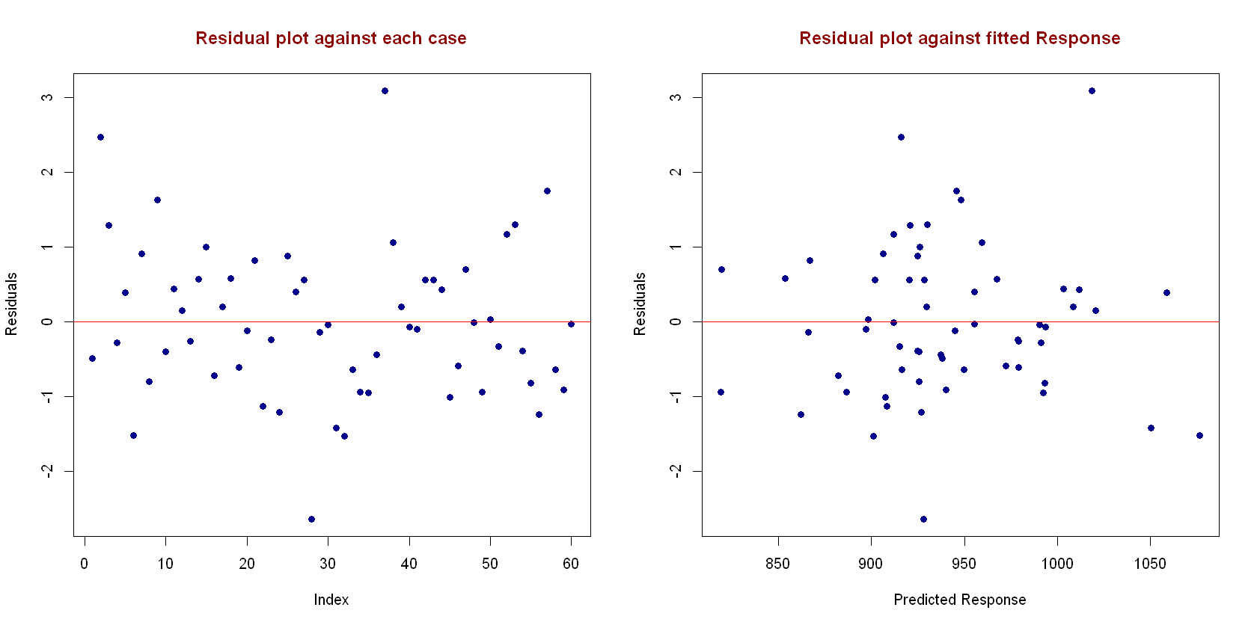
Plot of Residuals Against Sample Number and Fitted Response

Slide 37
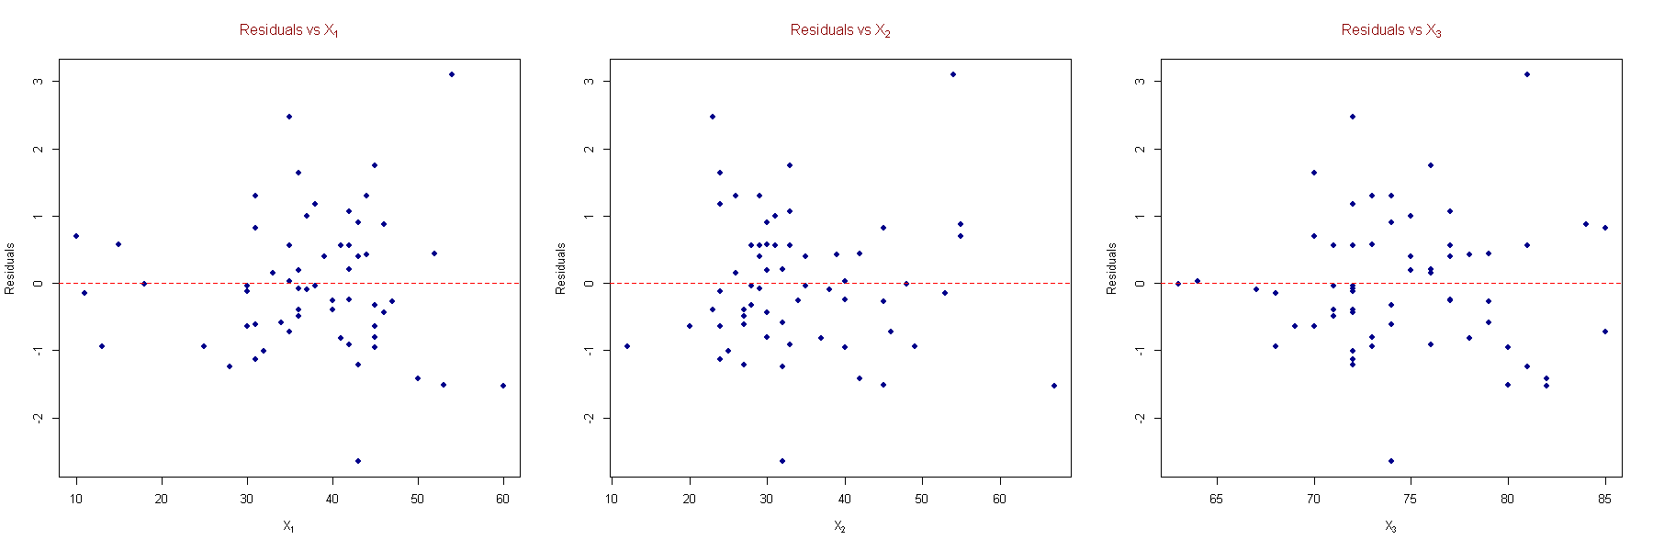
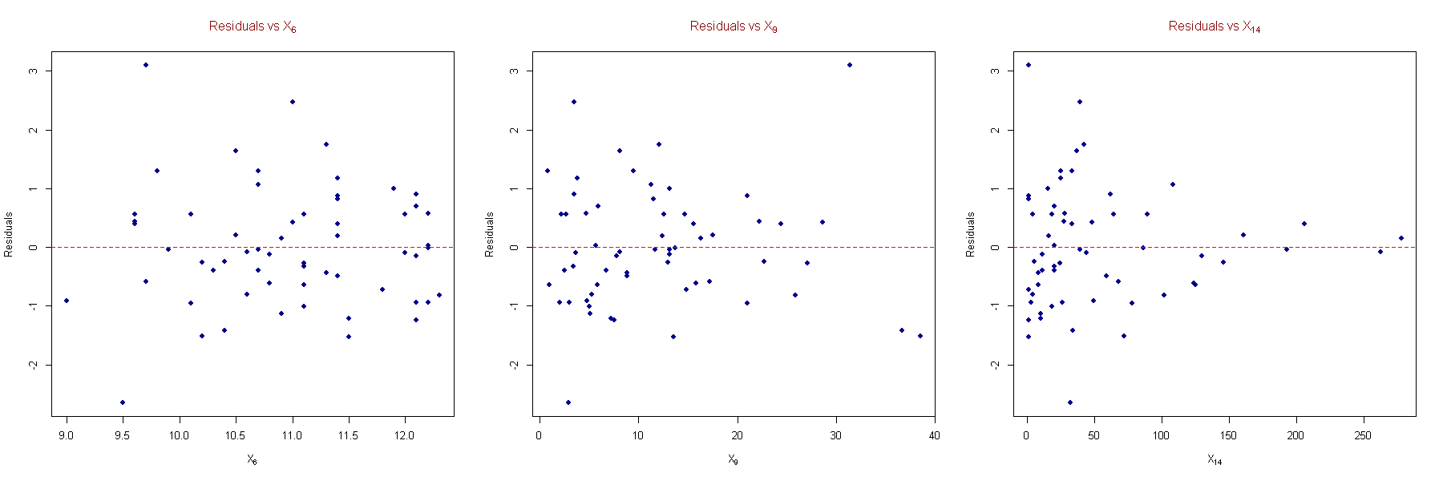
Plot of Residuals Against Remaining Regressors

Slide 38

In case of $X_{14}$ there seems to be an inward funnel in the plot. So we are going for Goldfeld-Quandt test for confirmation.
Heteroscedasticity Checking of the current model:
Goldfeld-Quandt test:
GQ = 1.0865, df1 = 13, df2 = 13, p-value = 0.4417
Alternative hypothesis : variance increases from segment 1 to 2
Conclusion:
Here the observed p-value (0.4417) of the Goldfeld-Quandt test is greater than the level of significance (0.05). Again, we can observe that the residual vs regressor plot for each regressor exhibit random behaviour in this new revised model as well. So we conclude that the residuals in the final model are homoscedastic.
Hence, our final model satisfies usual error assumptions and does not have multicollinearity among the regressors.

Slide 39
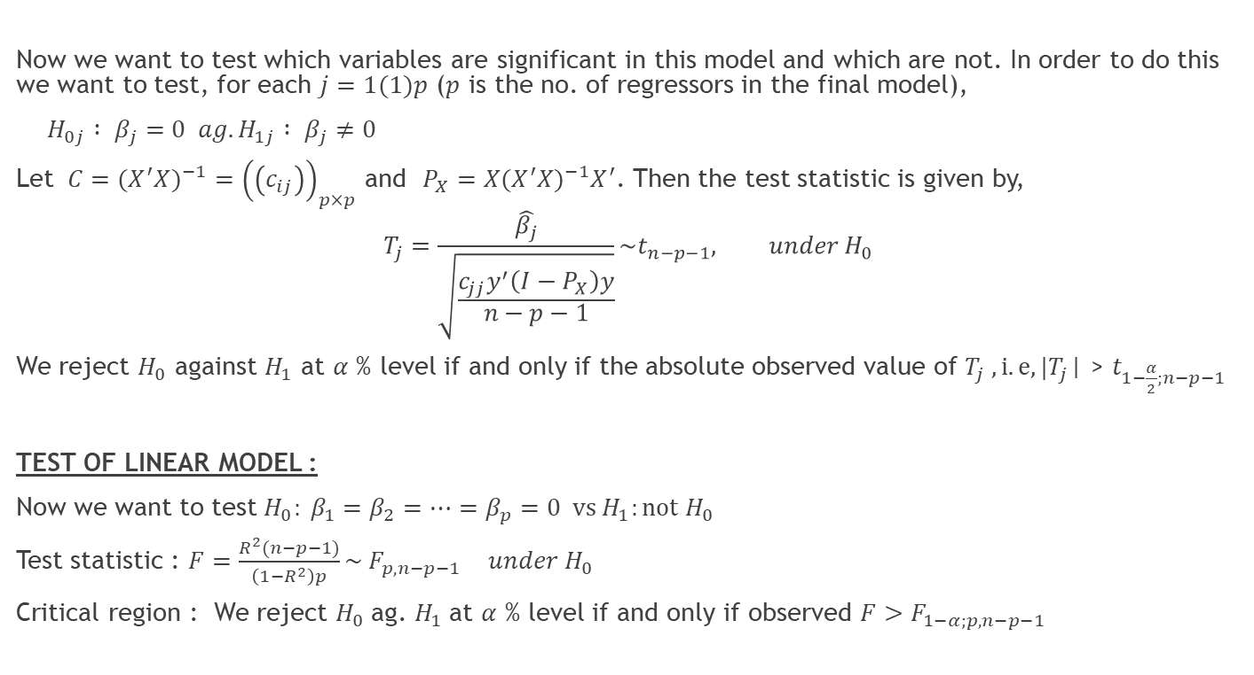
Test of Regression coefficient
Now we want to test which variables are significant in this model and which are not. In order to do this we want to test, for each $j=1(1)p$ ($p$ is the no. of regressors in the final model),
$H_{0j} : β_{j}=0 ag. H_{1j} : β_{j}≠0$
Let $C=(X^{′}X)^{−1}={\left(\left(c_{ij}\right)\right)}_{p×p}$ and $P_{X}=X(X^{′}X)^{−1}X^{′}$. Then the test statistic is given by,
$$T_{j}=\frac{\hat{β_{j}}}{\sqrt{\frac{c_{jj}y^{′}\left(I−P_{X}\right)y}{n−p−1}}}\sim t_{n−p−1}, under H_{0}$$
We reject $H_{0}$ against $H_{1}$ at $α$ % level if and only if the absolute observed value of $T_{j} , i.e, |T_{j}$| > $t_{1−\frac{α}{2};n−p−1}$
TEST OF LINEAR MODEL :
Now we want to test $H_{0}: β_{1}=β_{2}=…=β_{p}=0 \text{vs} H_{1}:\text{not} H_{0}$
Test statistic : $F=\frac{R^{2}(n−p−1)}{\left(1−R^{2}\right)p}\sim F_{p,n−p−1 } under H_{0}$
Critical region : We reject $H_{0}$ag. $H_{1}$at $α$ % level if and only if observed $F>F_{1−α;p,n−p−1}$

Slide 40
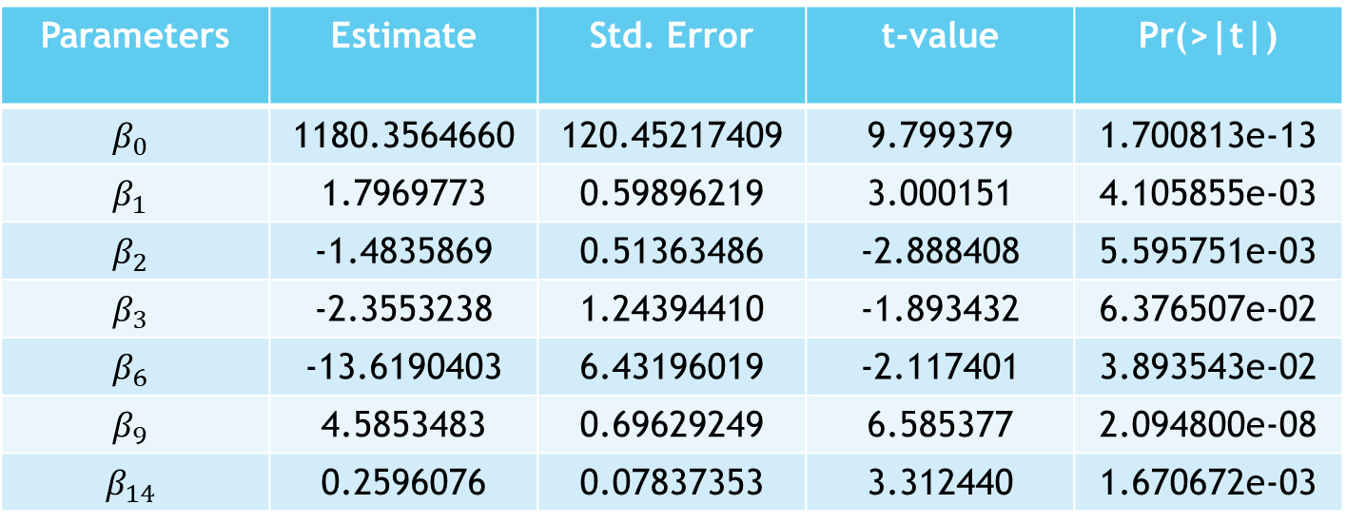
Estimates of the Regression Coefficient:
Parameters | Estimate | Std. Error | t-value | Pr(>|t|)
$$β_{0}$$ | 1180.3564660 | 120.45217409 | 9.799379 | 1.700813e-13
$$β_{1}$$ | 1.7969773 | 0.59896219 | 3.000151 | 4.105855e-03
$$β_{2}$$ | -1.4835869 | 0.51363486 | -2.888408 | 5.595751e-03
$$β_{3}$$ | -2.3553238 | 1.24394410 | -1.893432 | 6.376507e-02
$$β_{6}$$ | -13.6190403 | 6.43196019 | -2.117401 | 3.893543e-02
$$β_{9}$$ | 4.5853483 | 0.69629249 | 6.585377 | 2.094800e-08
$$β_{14}$$ | 0.2596076 | 0.07837353 | 3.312440 | 1.670672e-03

Slide 41

FINAL FITTED MODEL
Our final fitted model is :
$$MORT=1180.356+1.797∙PREC−1.484∙JANT−2.355∙JULT−13.619∙EDUC$$
$$+4.585∙NONW+0.260∙SO2$$

Slide 42
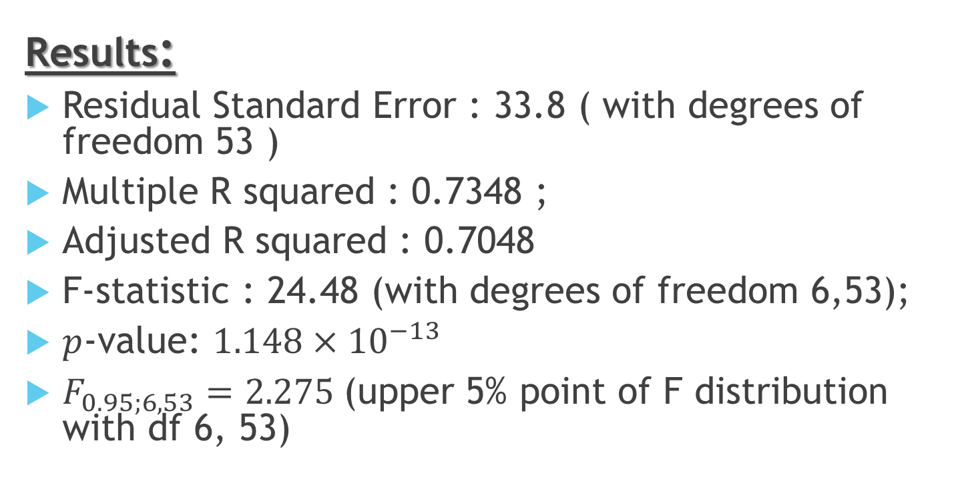
Model Fitting Diagnostics of the Final Model:
Results:
Residual Standard Error : 33.8 ( with degrees of freedom 53 )
Multiple R squared : 0.7348 ;
Adjusted R squared : 0.7048
F-statistic : 24.48 (with degrees of freedom 6,53);
$p$-value: $1.148×{10}^{−13}$
$F_{0.95;6,53}=2.275$(upper 5% point of F distribution with df 6, 53)

Slide 43
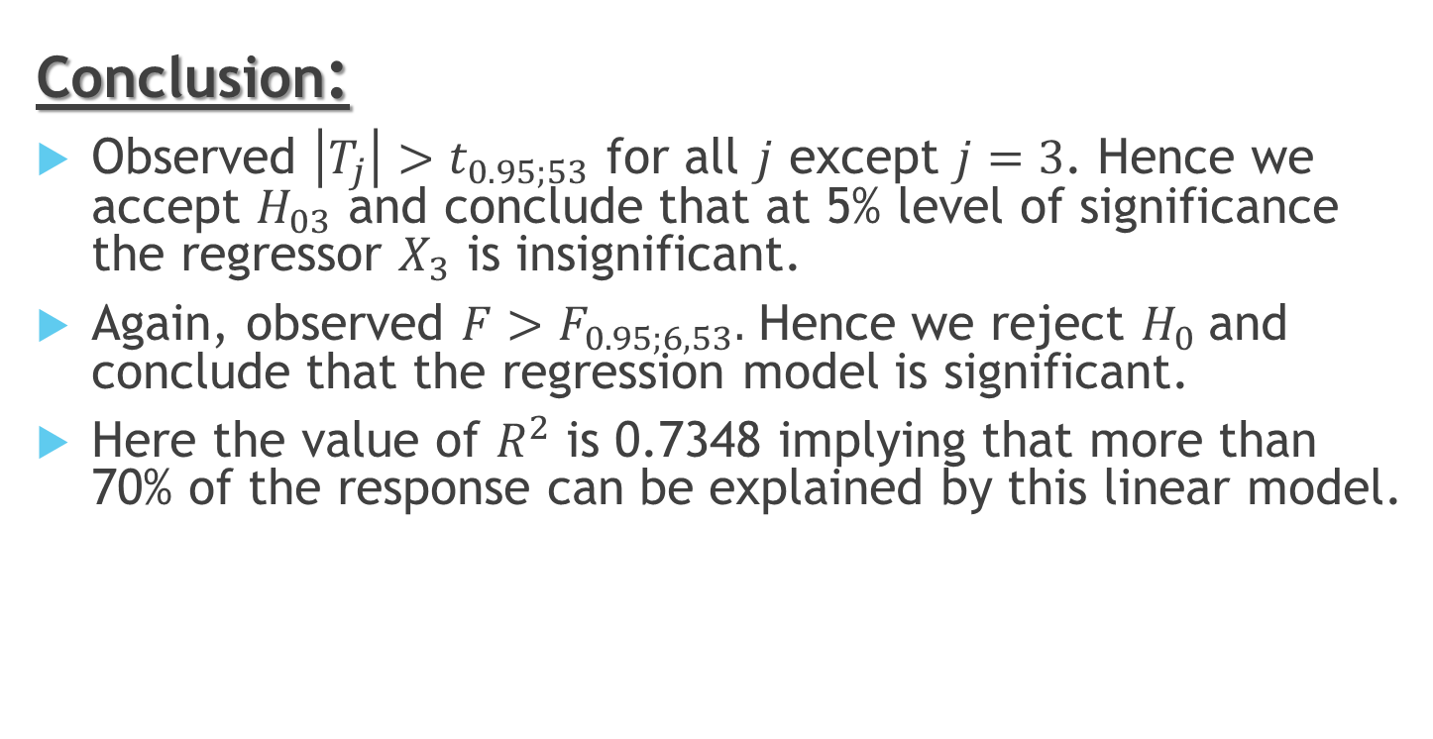
Model Fitting Diagnostics of the Final Model:
Conclusion:
Observed $\left|T_{j}\right|>t_{0.95;53}$ for all $j$ except $j=3$. Hence we accept $H_{03}$ and conclude that at 5% level of significance the regressor $X_{3}$ is insignificant.
Again, observed $F>F_{0.95;6,53}.$ Hence we reject $H_{0}$and conclude that the regression model is significant.
Here the value of $R^{2}$ is 0.7348 implying that more than 70% of the response can be explained by this linear model.

Slide 44
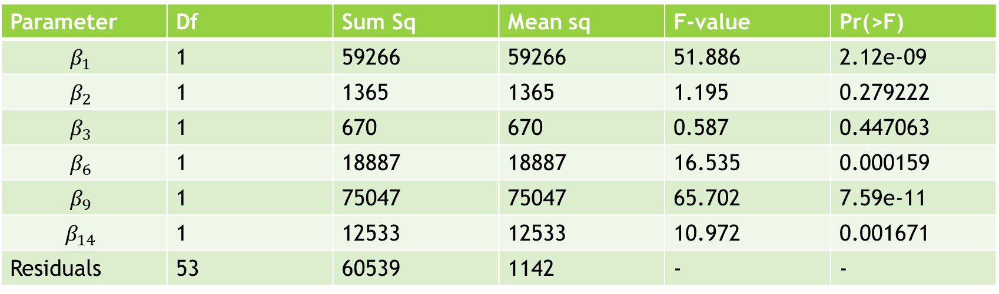
ANOVA TABLE & MODEL SUMMARY
Parameter | Df | Sum Sq | Mean sq | F-value | Pr(>F)
$$β_{1}$$ | 1 | 59266 | 59266 | 51.886 | 2.12e-09
$$β_{2}$$ | 1 | 1365 | 1365 | 1.195 | 0.279222
$$β_{3}$$ | 1 | 670 | 670 | 0.587 | 0.447063
$$β_{6}$$ | 1 | 18887 | 18887 | 16.535 | 0.000159
$$β_{9}$$ | 1 | 75047 | 75047 | 65.702 | 7.59e-11
$$β_{14}$$ | 1 | 12533 | 12533 | 10.972 | 0.001671
Residuals | 53 | 60539 | 1142 | - | -

Slide 45
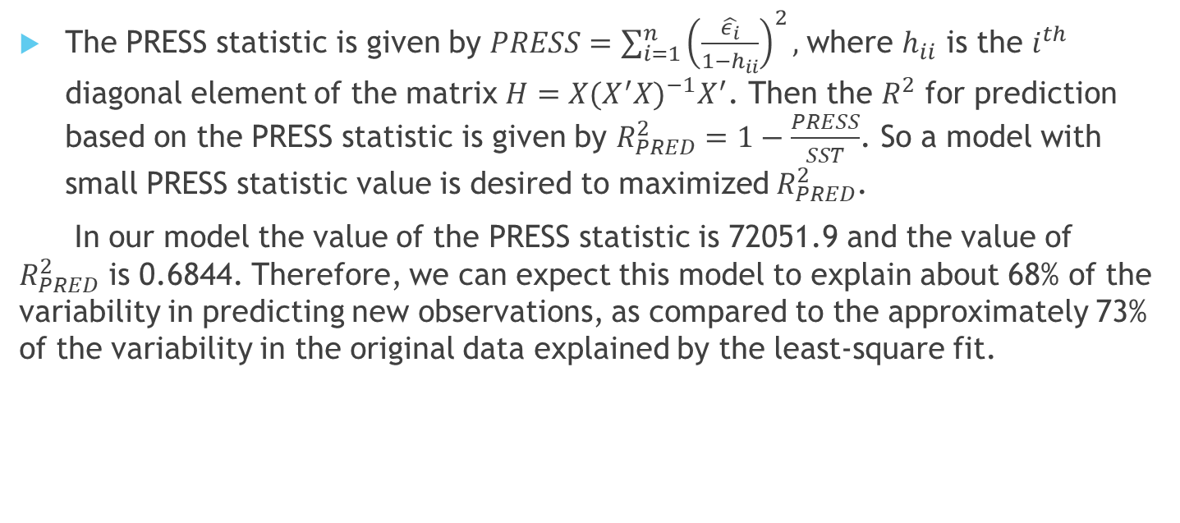
Evaluation of the Final Model : the PRESS Statistic:
The PRESS statistic is given by $PRESS=\sum_{i=1}^{n}{{\left(\frac{\hat{ε_{i}}}{1−h_{ii}}\right)}^{2}},$where $h_{ii}$ is the $i^{th}$ diagonal element of the matrix $H=X(X^{′}X)^{−1}X^{′}$. Then the $R^{2}$ for prediction based on the PRESS statistic is given by $R_{PRED}^{2}=1−\frac{PRESS}{SST}$. So a model with small PRESS statistic value is desired to maximized $R_{PRED}^{2}$.
In our model the value of the PRESS statistic is 72051.9 and the value of $R_{PRED}^{2}$ is 0.6844. Therefore, we can expect this model to explain about 68% of the variability in predicting new observations, as compared to the approximately 73% of the variability in the original data explained by the least-square fit.

Slide 46
CONCLUSION
Based on the final model we can conclude that,
Average annual precipitation
Average temperature in January and July
Median School years completed
Percentage of non-white population in urbanized area
Relative pollution potential of SO₂
has significant linear effect in predicting the mortality rate of the persons living in that area. Moreover it is quite natural that this socio economic factors will surely affect the life of a person in a linear fashion.
For example if annual precipitation is on the higher side then the area will be more homogenous place to live in but excess or lower rainfall will make lifestyle harder thus affecting lives. Same is true for the temperature or the pollution level in the air. So based on our study we could predict the age adjusted mortality rate given the factors with an accuracy of nearly 68%.

Slide 47
REFERENCE
1. Introduction to linear regression analysis by Douglas c. Montgomery, Elizbeth A . peck,G. Geoffrey vining.
2. Class Notes by Prof. Sharmishta Mitra at IIT Kanpur, Dept. of Mathematics and Statistics
4. Wikipedia
5. Numerous blogposts related to statistics. Eg. - R-bloggers,STHDA etc.

Slide 48
ACKNOWLEDGEMENT
Our journey of accomplishing this project really involves many ones to whom we are highly obliged. We would like to express our deepest appreciation to all those who have provided us the possibility to complete this project. We give a special gratitude to our respected instructor Dr. Sharmishtha Mitra, Department of Mathematics and Statistics, IITKANPUR, whose contribution in stimulating suggestion, valuable guidance, constructive criticism and encouragement help us to coordinate our project.
We take the privilege to thank the authors and publishers of the various books we have consulted. Also thanks to the Wikipedia and various other free website from which we got help. At last we would like to thank our seniors and batch mates for their co-operation throughout the project. Without their guidance and supervision this project would not have been completed.

Slide 49
THANK
YOU

